Slide 1

CMPE/SE 257 Machine Learning Feb 26
Department of Computer engineering
San José state University
Spring 2018
Instructor :Bhavana Bhasker

Slide 2
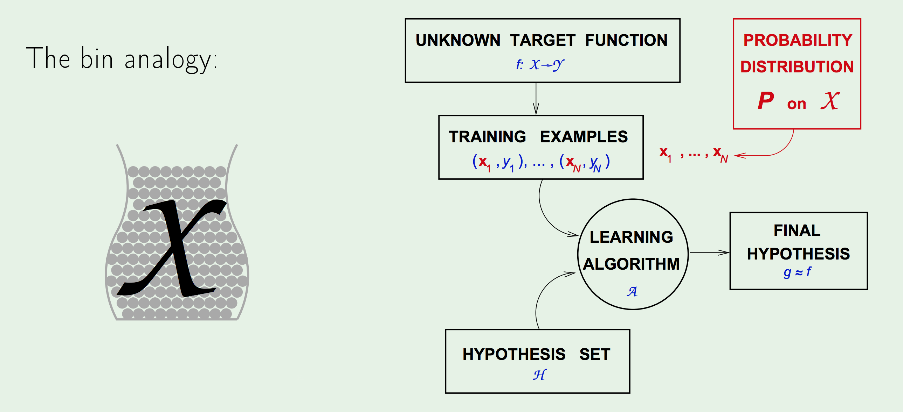
Hoeffding’s Inequality : Connection to learning

Slide 3
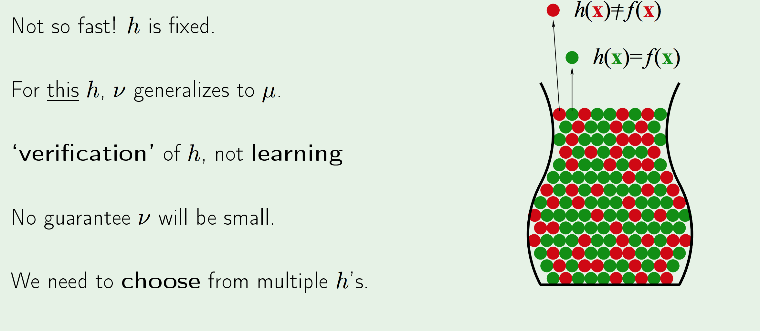
Hoeffding’s Inequality :Are we done?

Slide 4
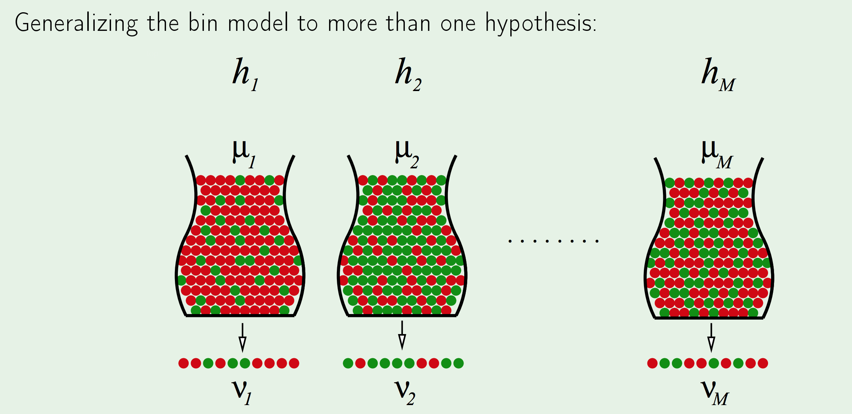
Hoeffding’s Inequality :Multiple bins

Slide 5
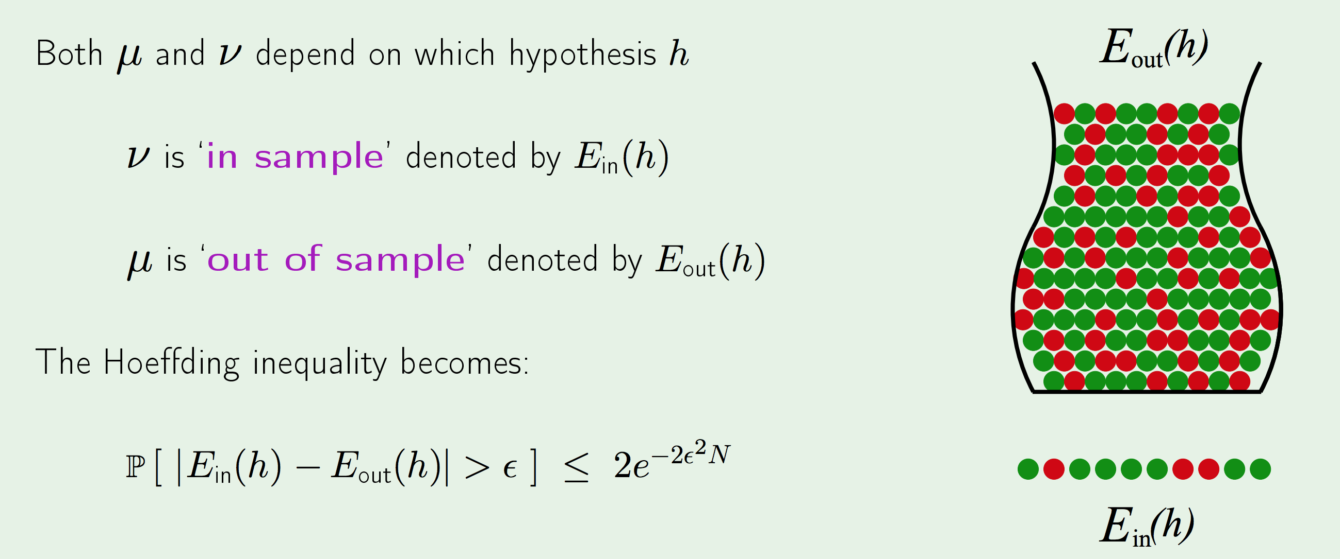
Hoeffding’s Inequality :Notations for learning

Slide 6
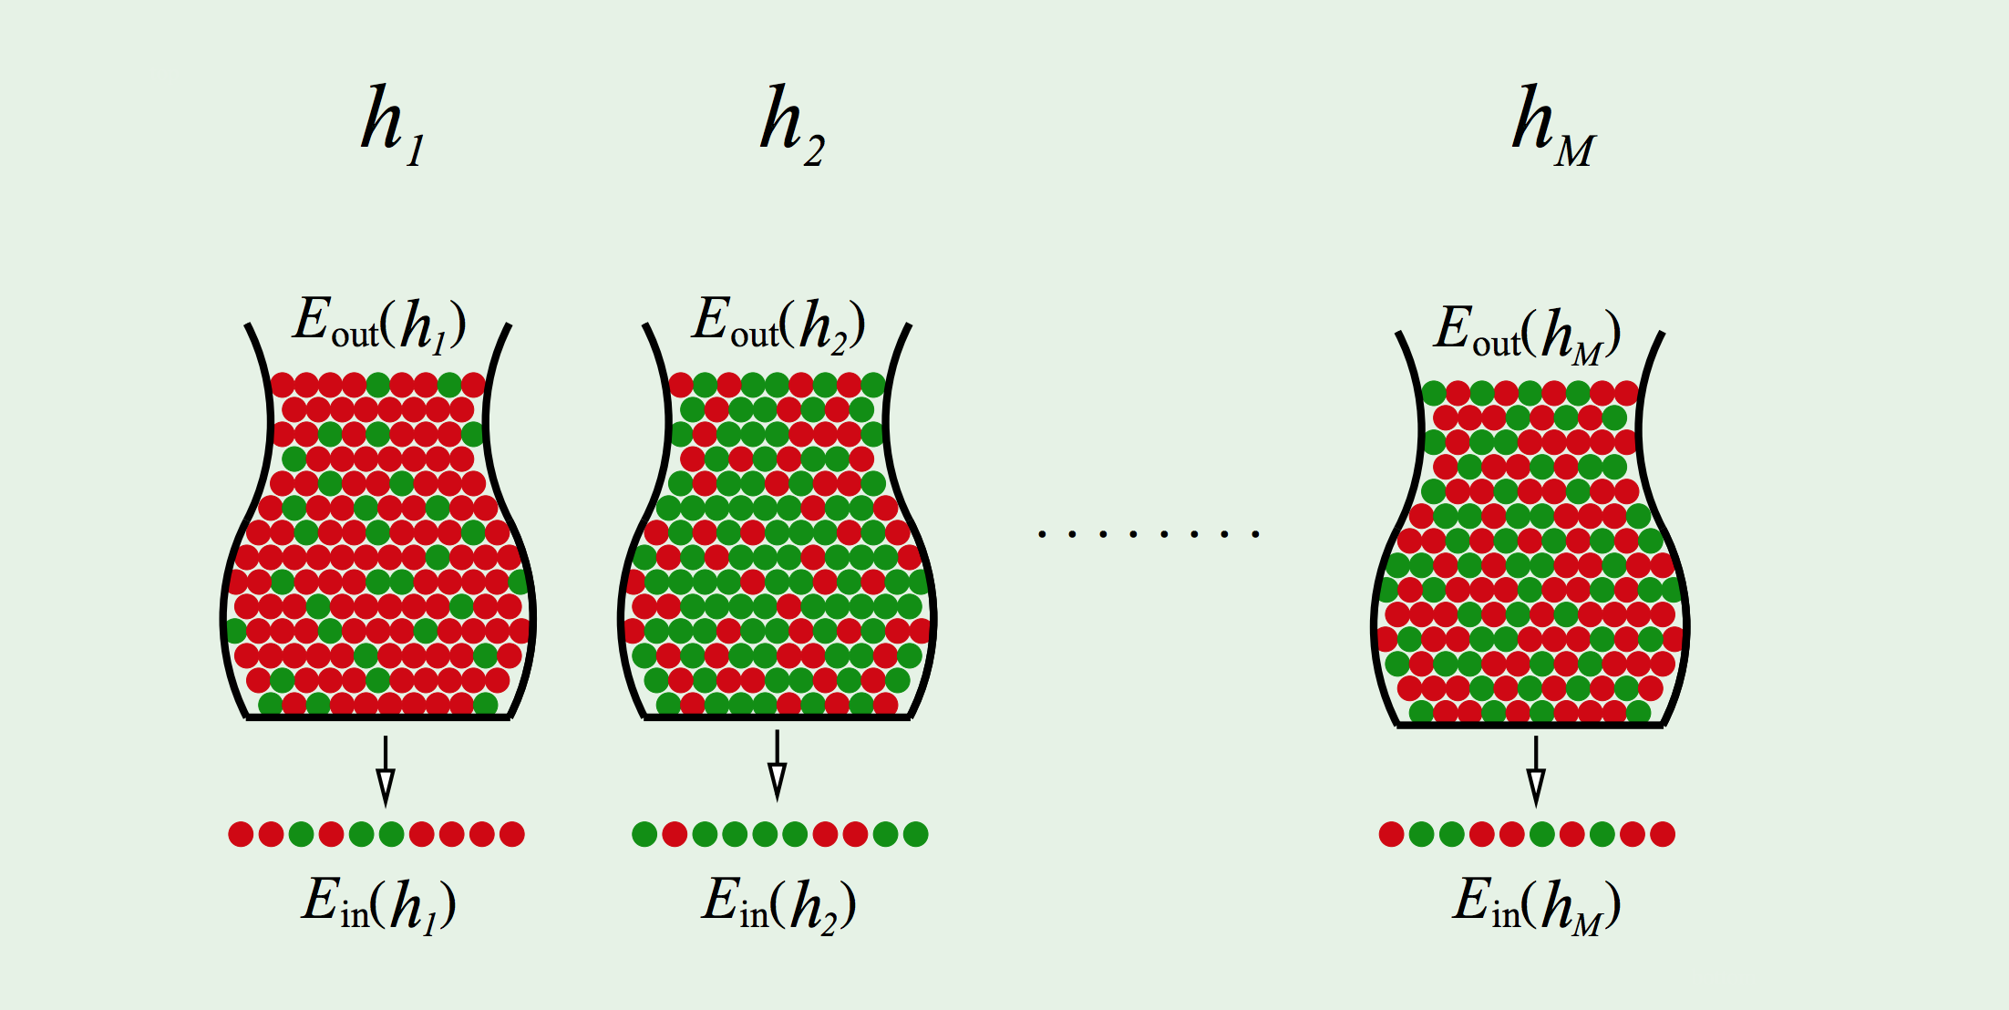
Hoeffding’s Inequality :Notations with multiple bins

Slide 7
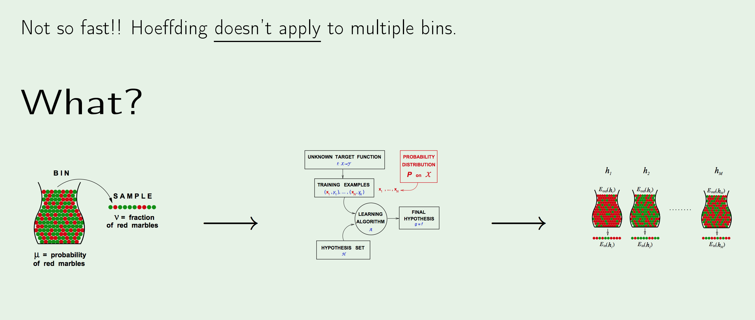
Hoeffding’s Inequality :Are we done already?

Slide 8
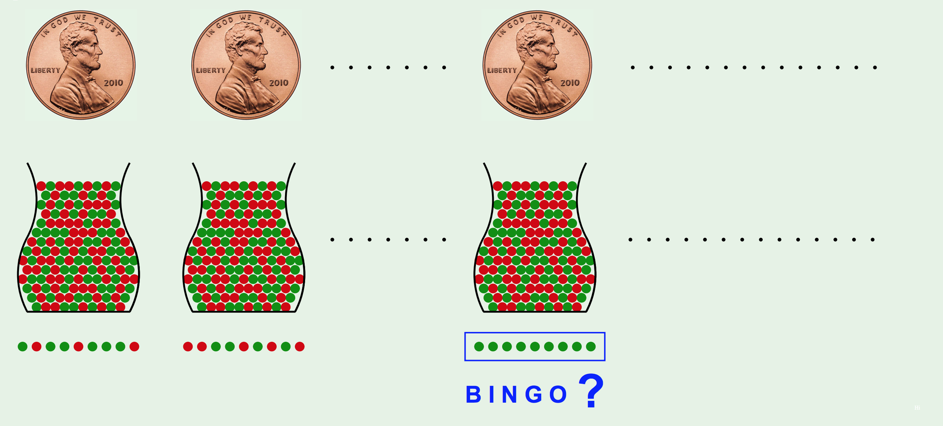
Hoeffding’s Inequality : Multiple bins

Slide 9
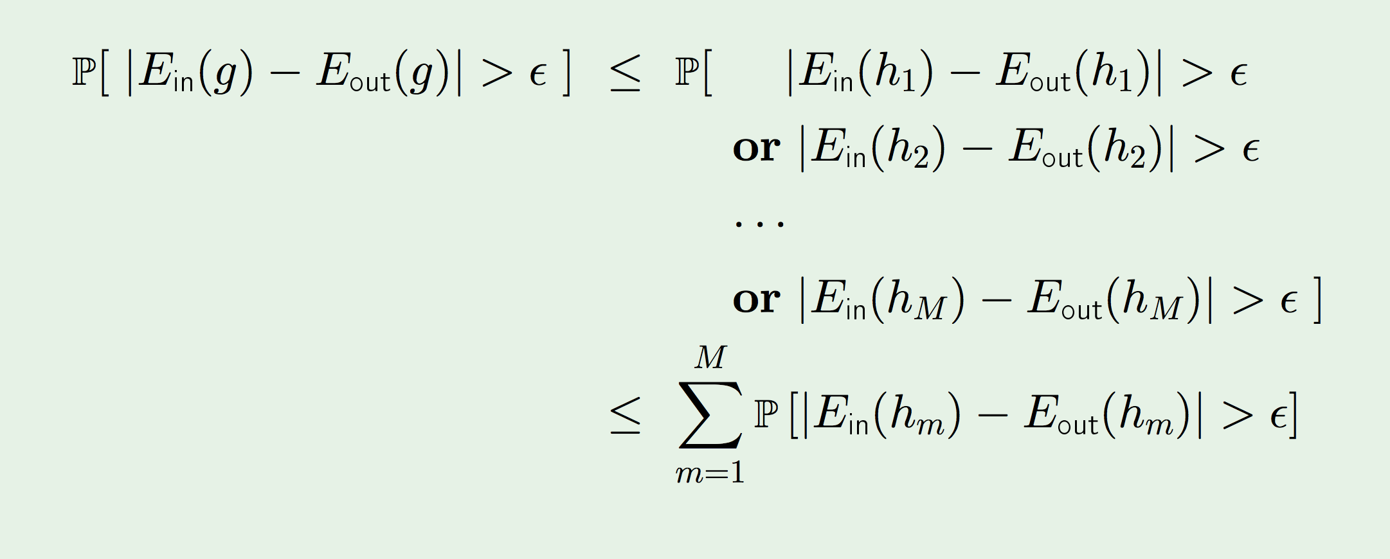
Hoeffding’s Inequality : Multiple bins

Slide 10
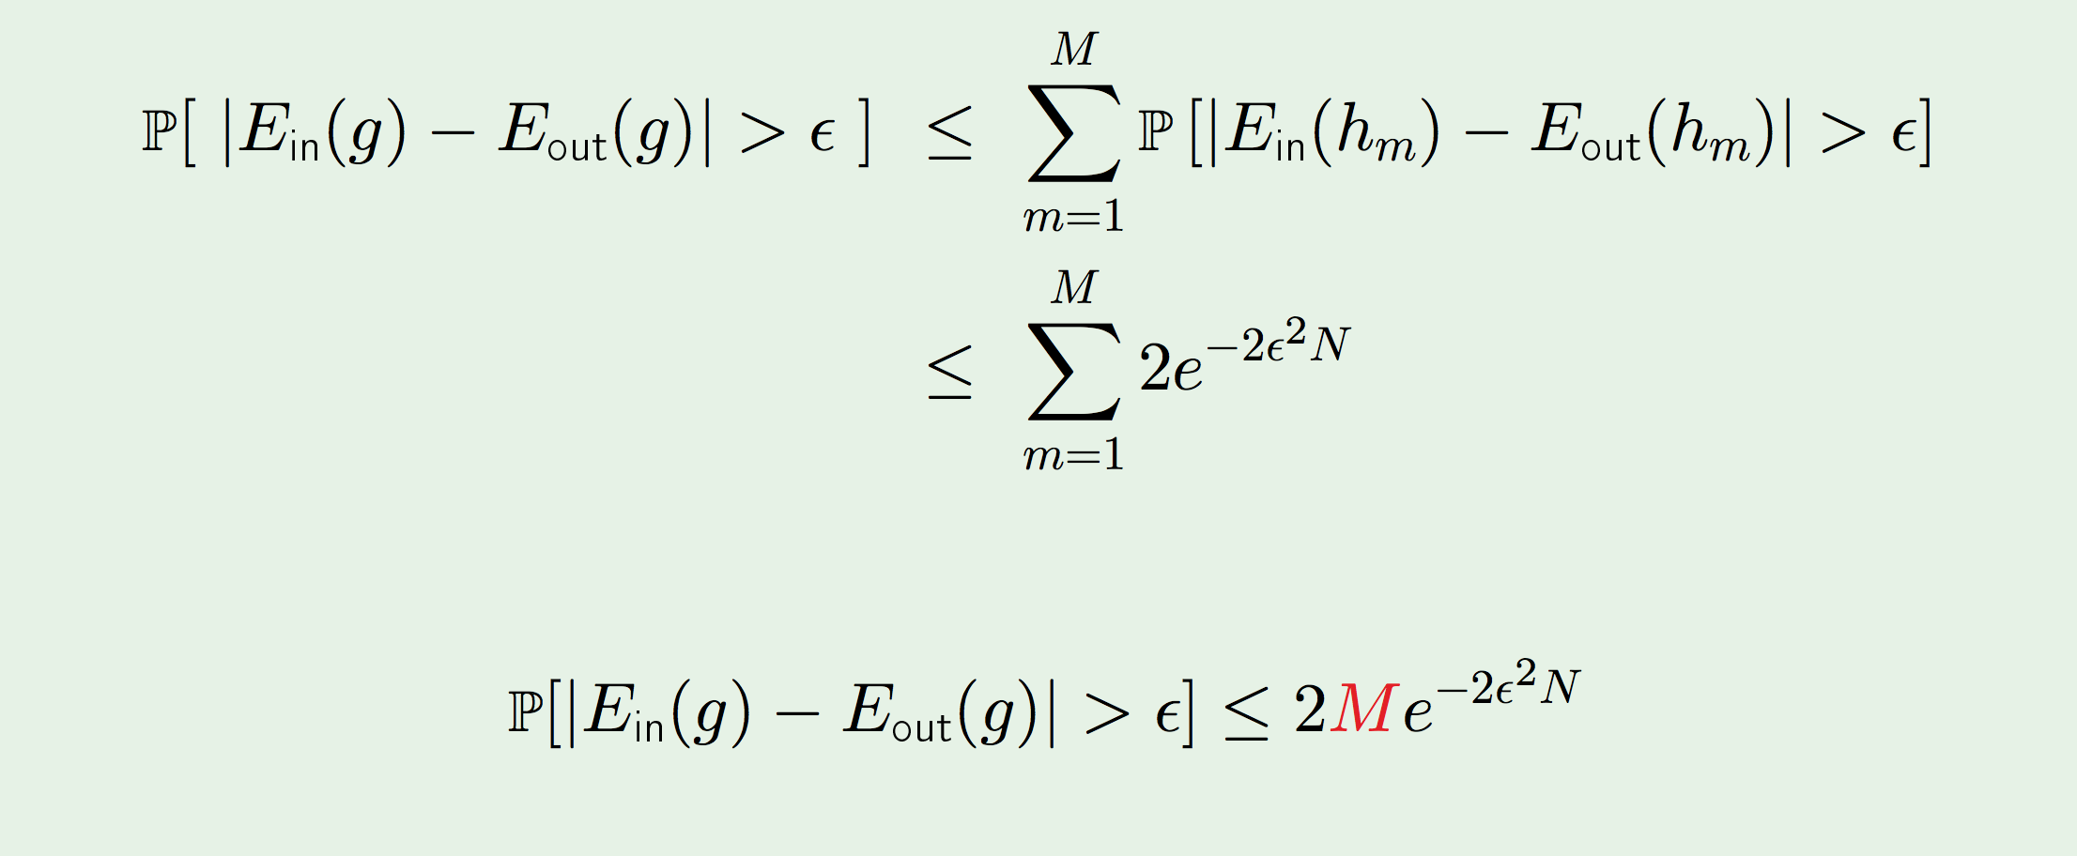
Hoeffding’s Inequality : Multiple bins

Slide 11
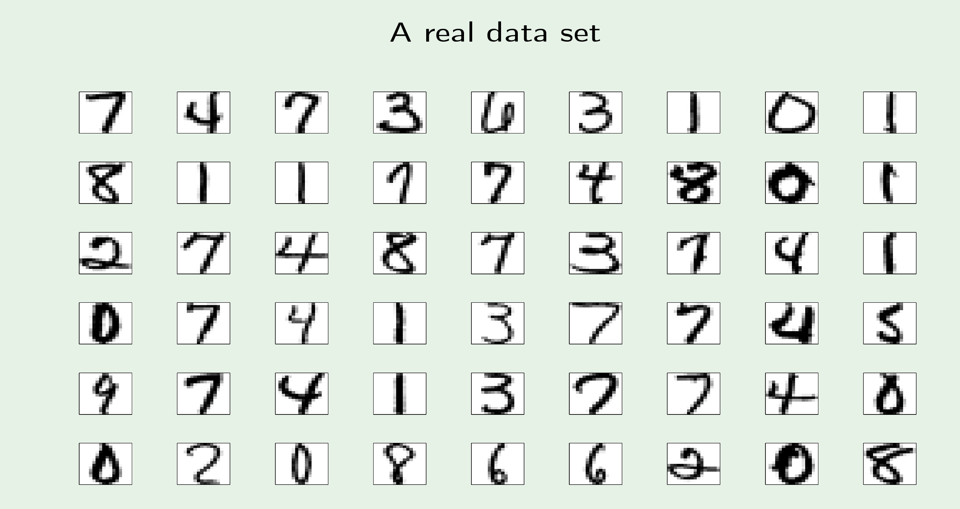
Linear Models : A real data set

Slide 12
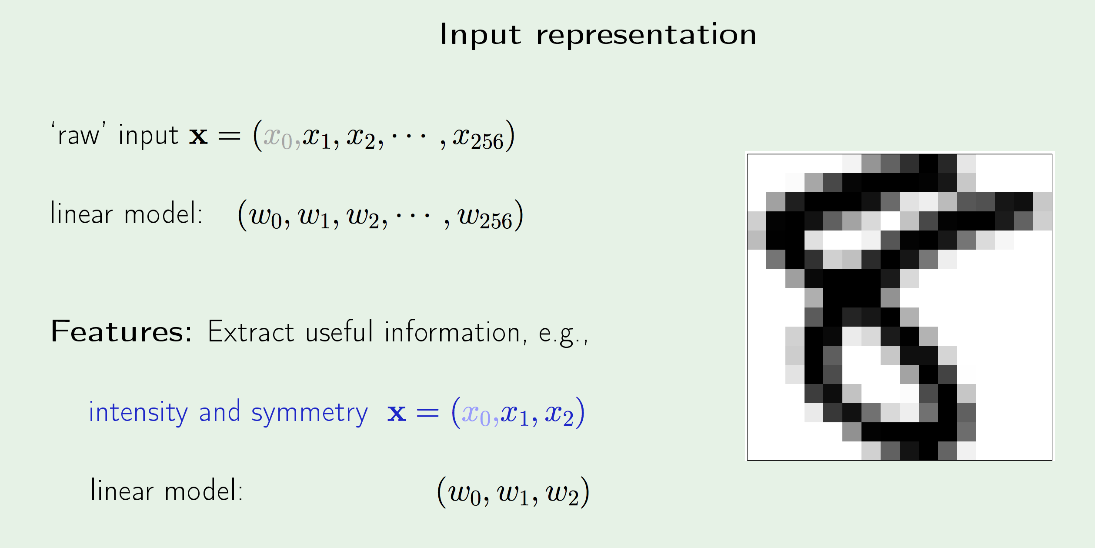
Linear Model : Input Representation

Slide 13
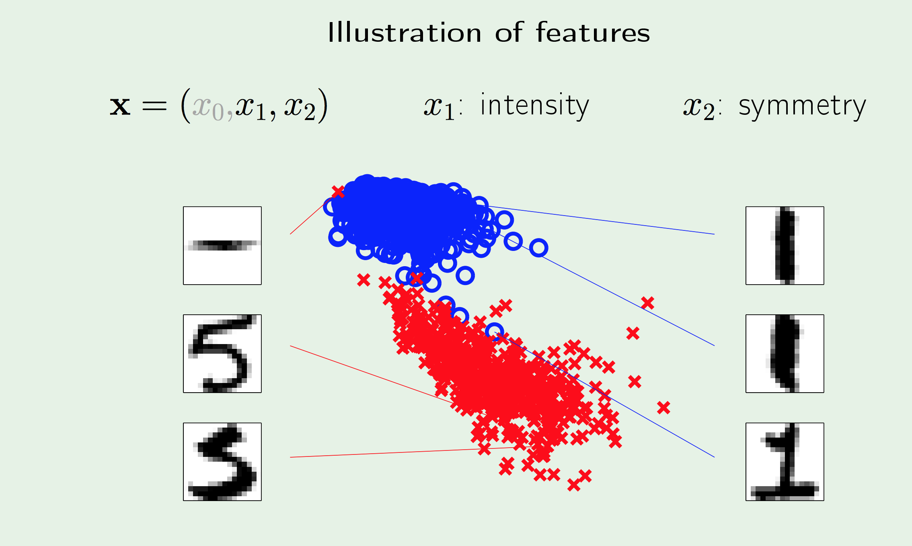
Linear Model : Illustration of features

Slide 14
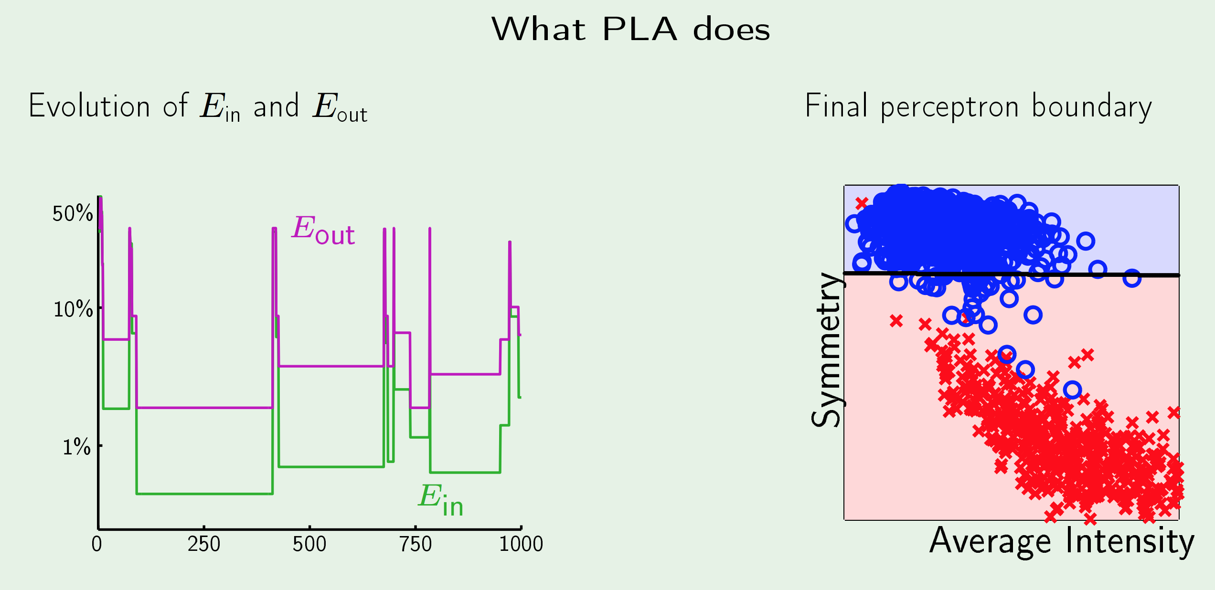
Linear Model : PLA

Slide 15
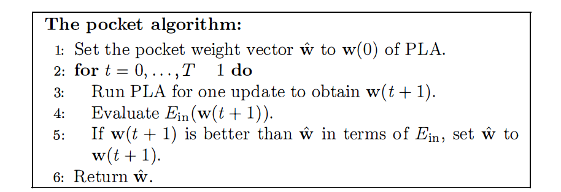
Linear Model : Pocket Algorithm

Slide 16
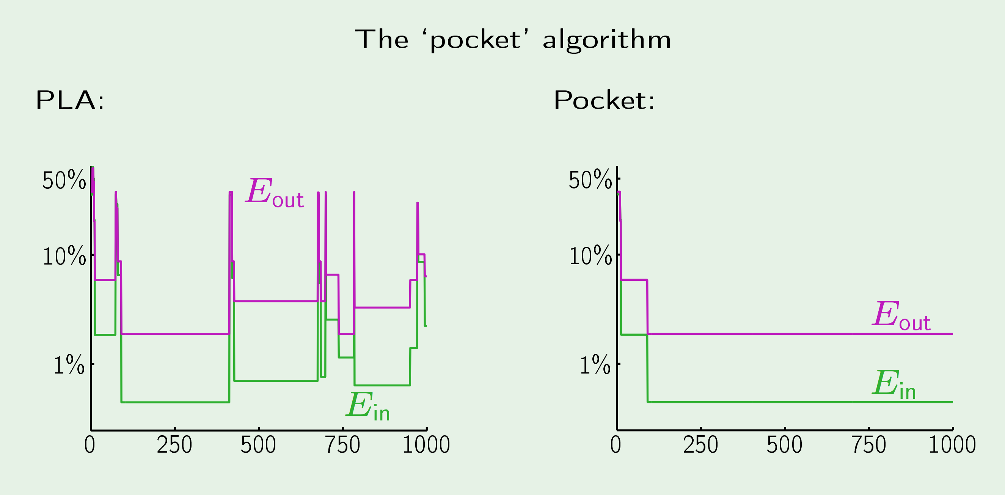
Linear Model : Pocket Algorithm

Slide 17
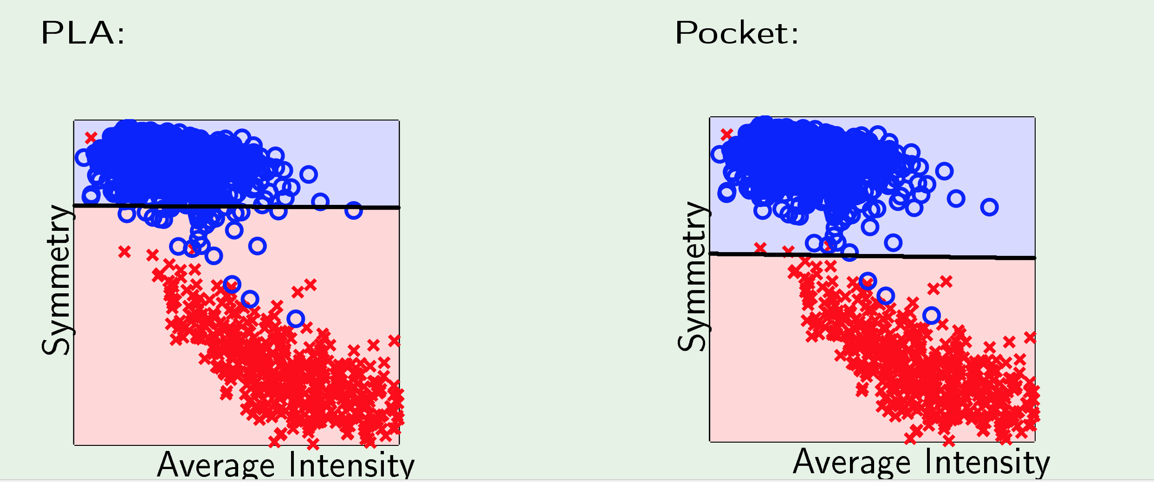
Classification boundary – PLA v/s Pocket

Slide 18
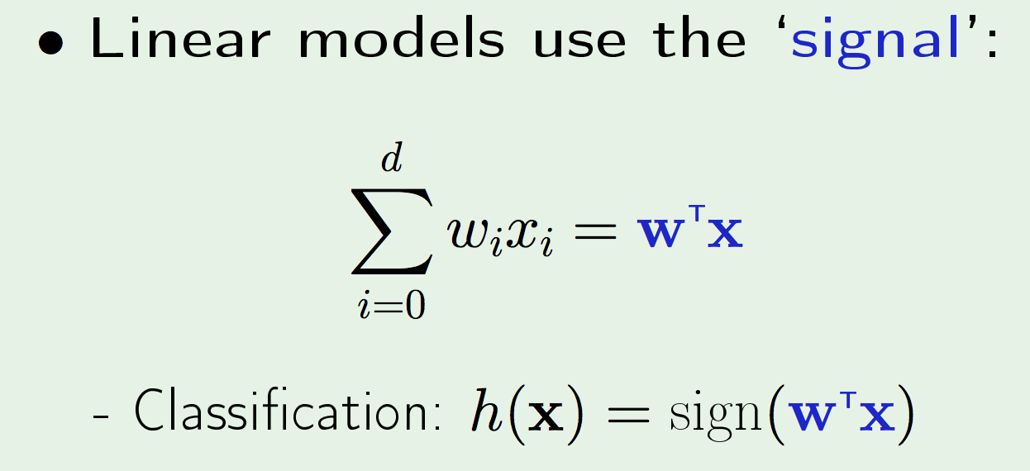
Linear Classification

Slide 19
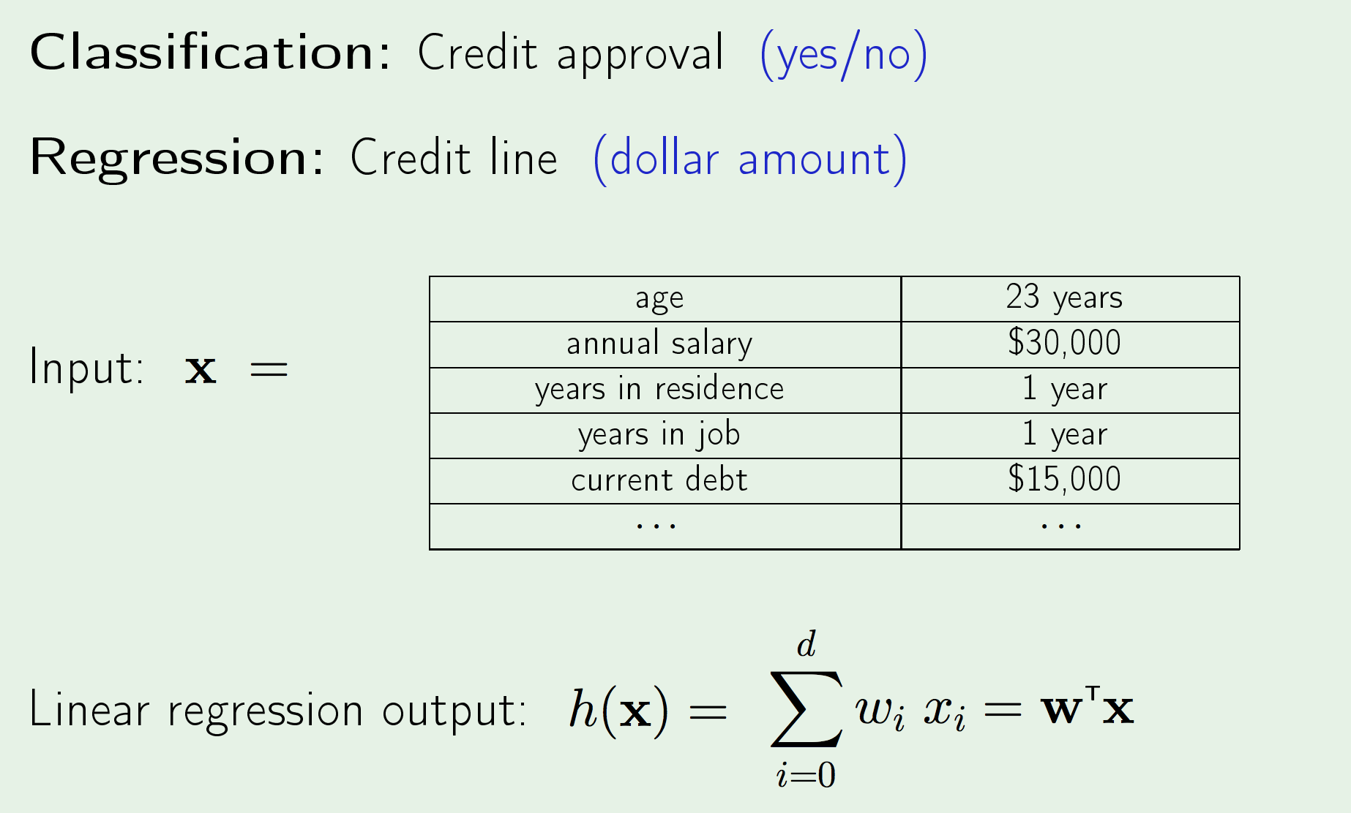
Linear Regression – Data Set

Slide 20
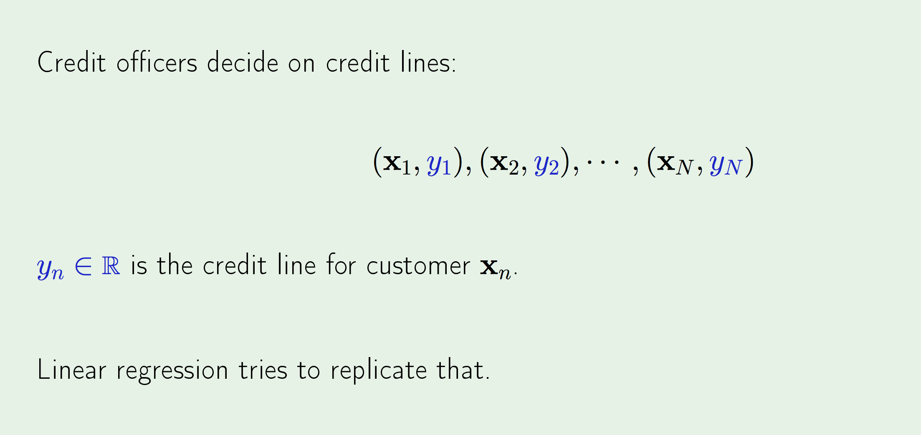
Linear Regression : Data Set

Slide 21
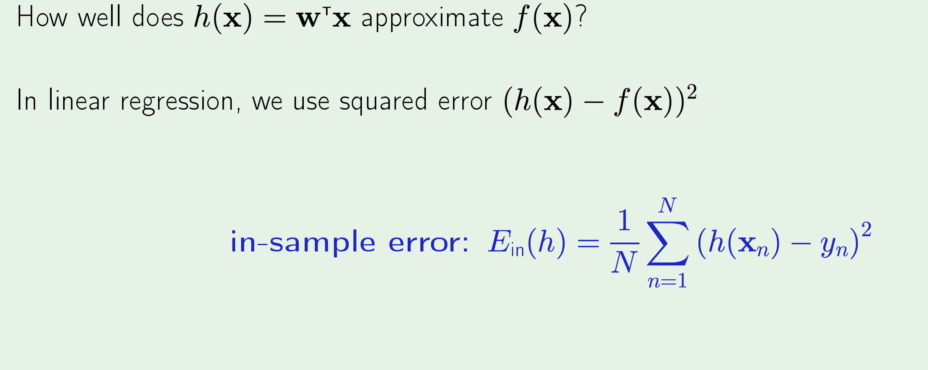
Linear Regression – How to measure error?

Slide 22
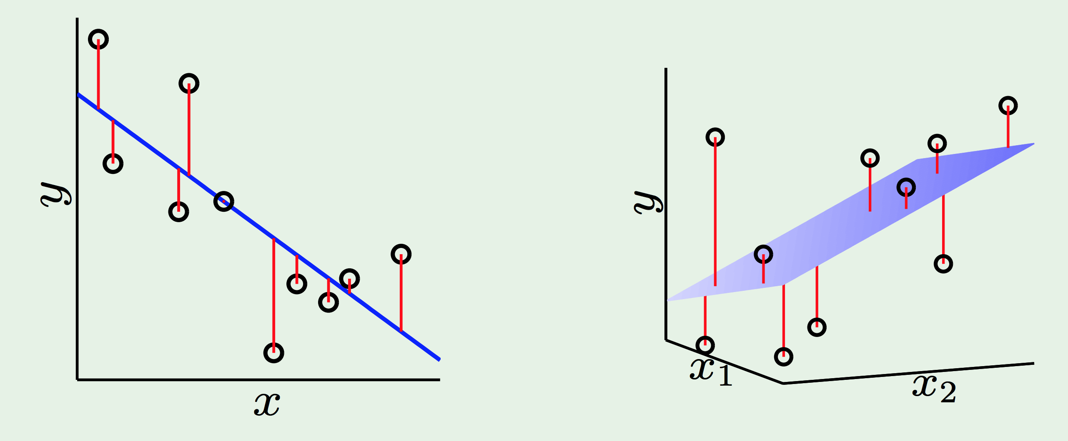
Linear Regression : Illustration

Slide 23
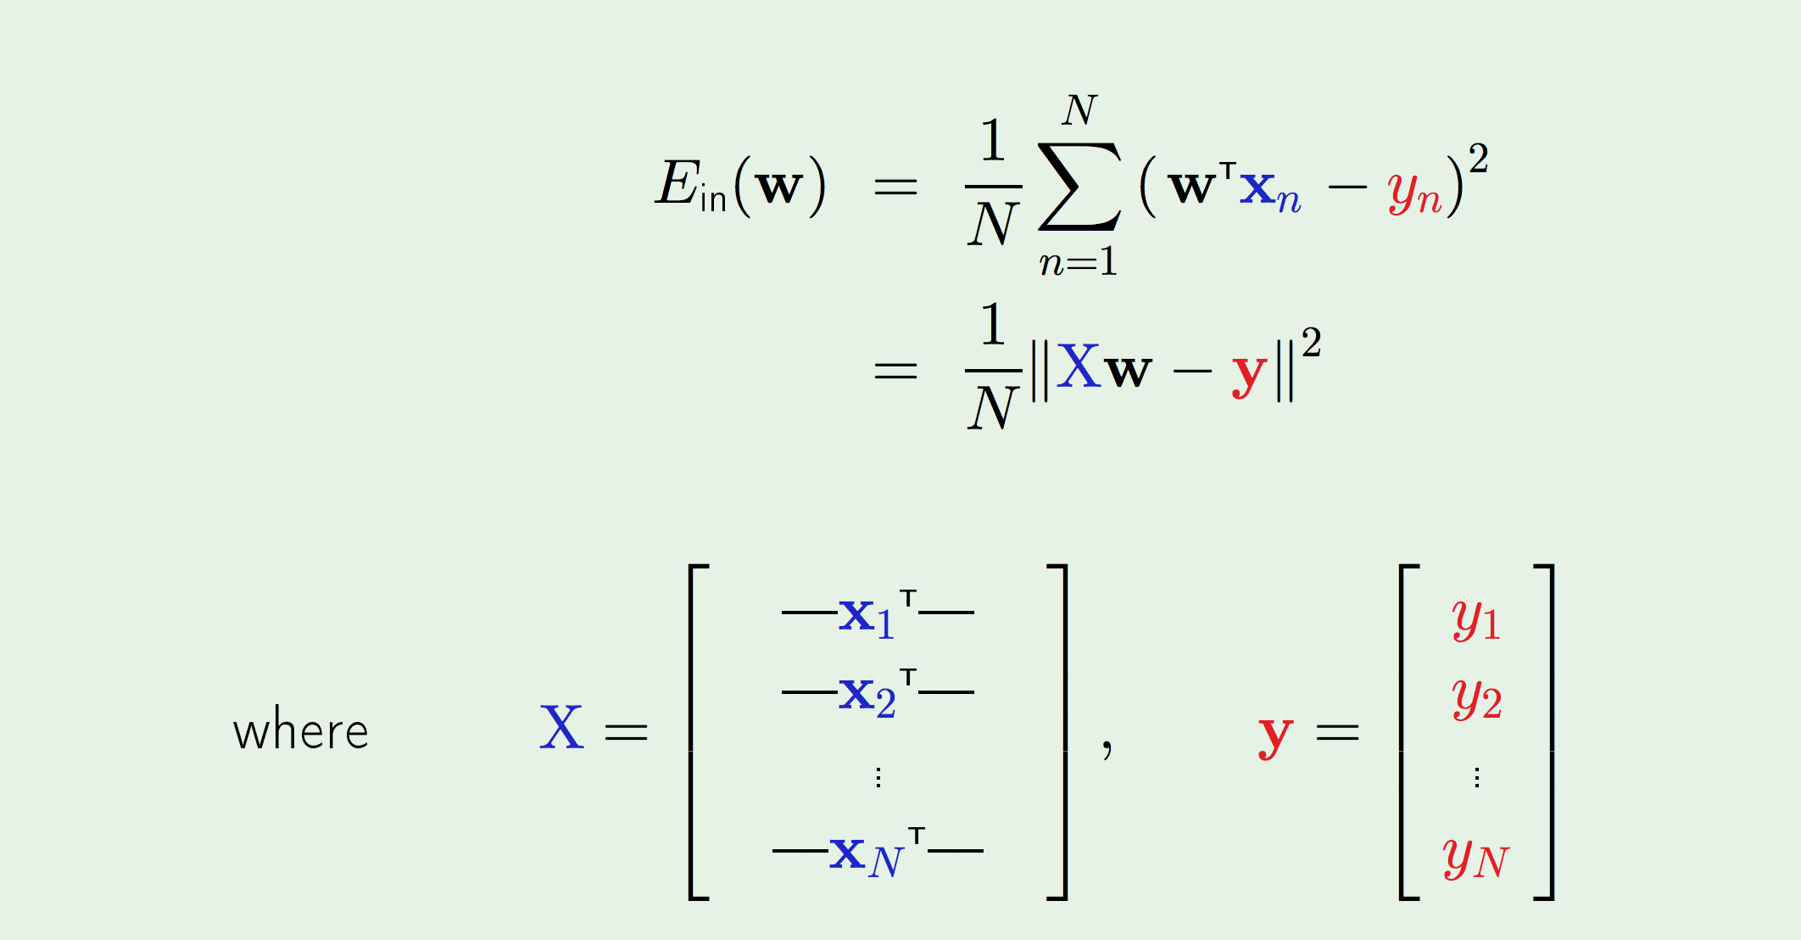
Linear Regression : In-sample error

Slide 24
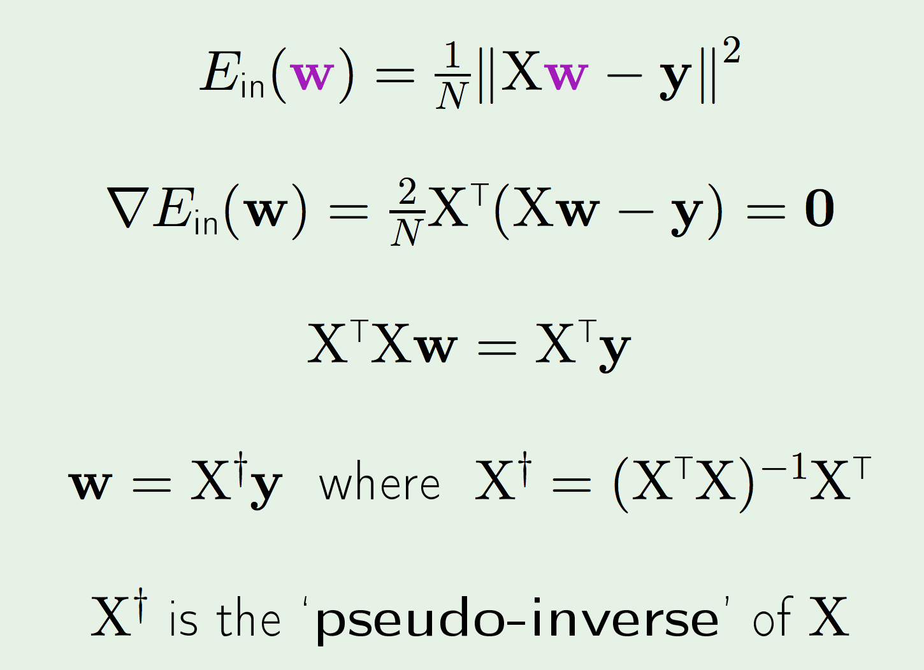
Linear Regression : In-sample Error

Slide 25
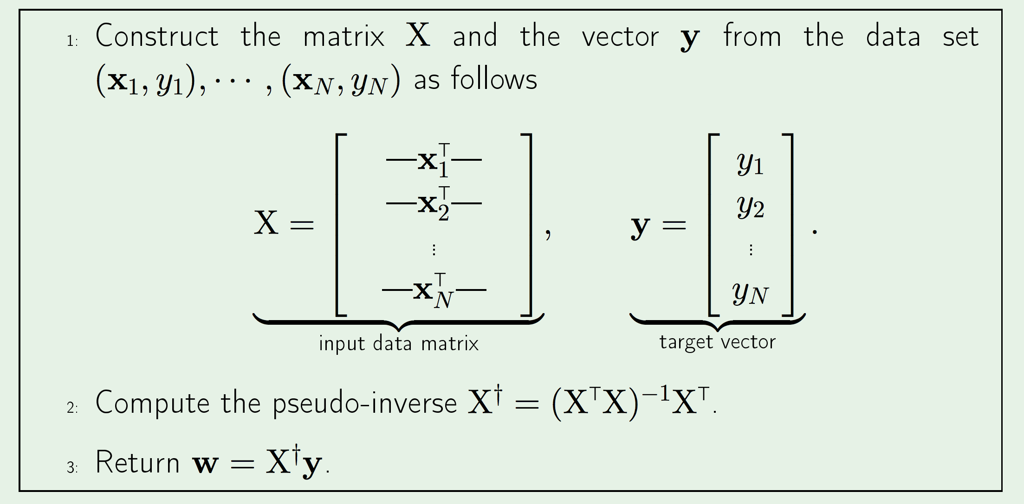
Linear Regression Algorithm

Slide 26
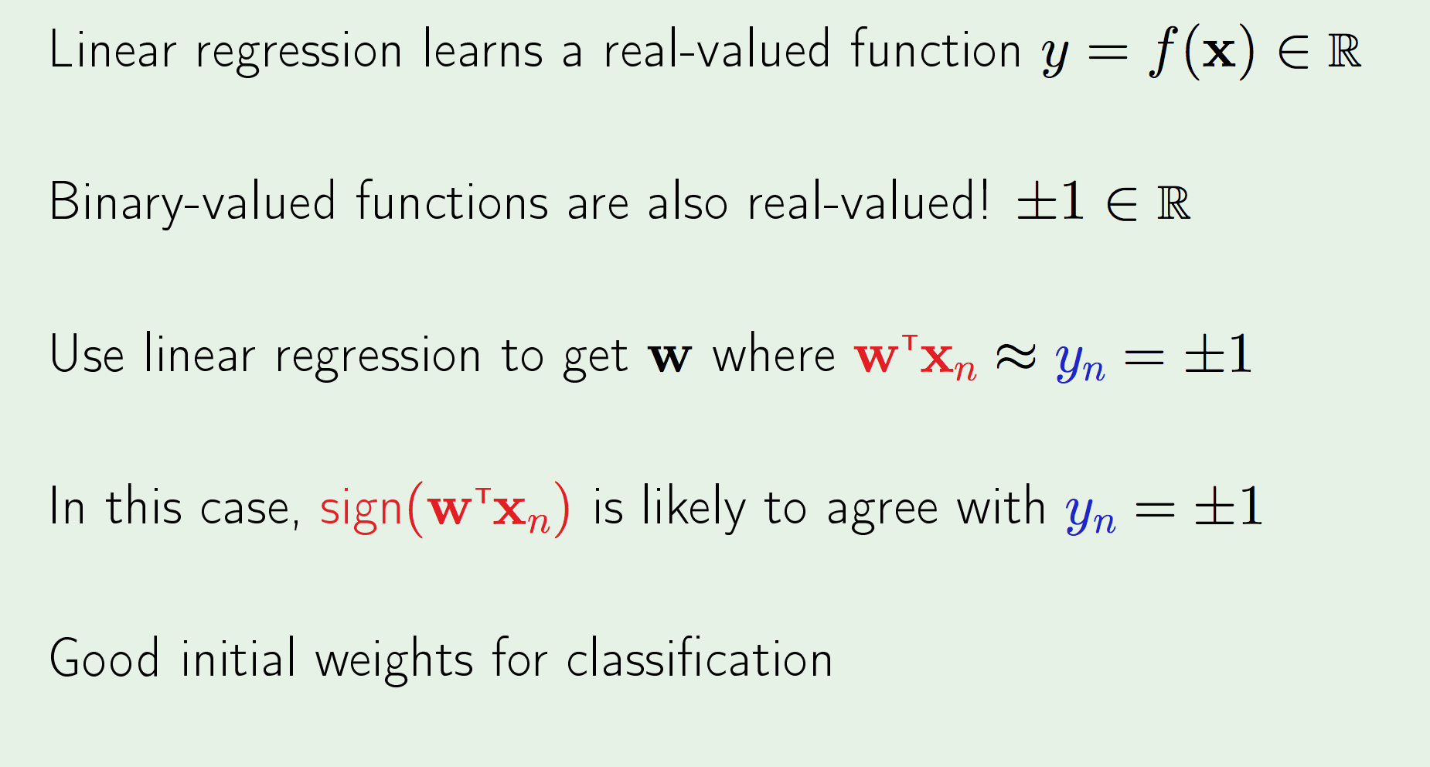
Linear Regression for Classification

Slide 27
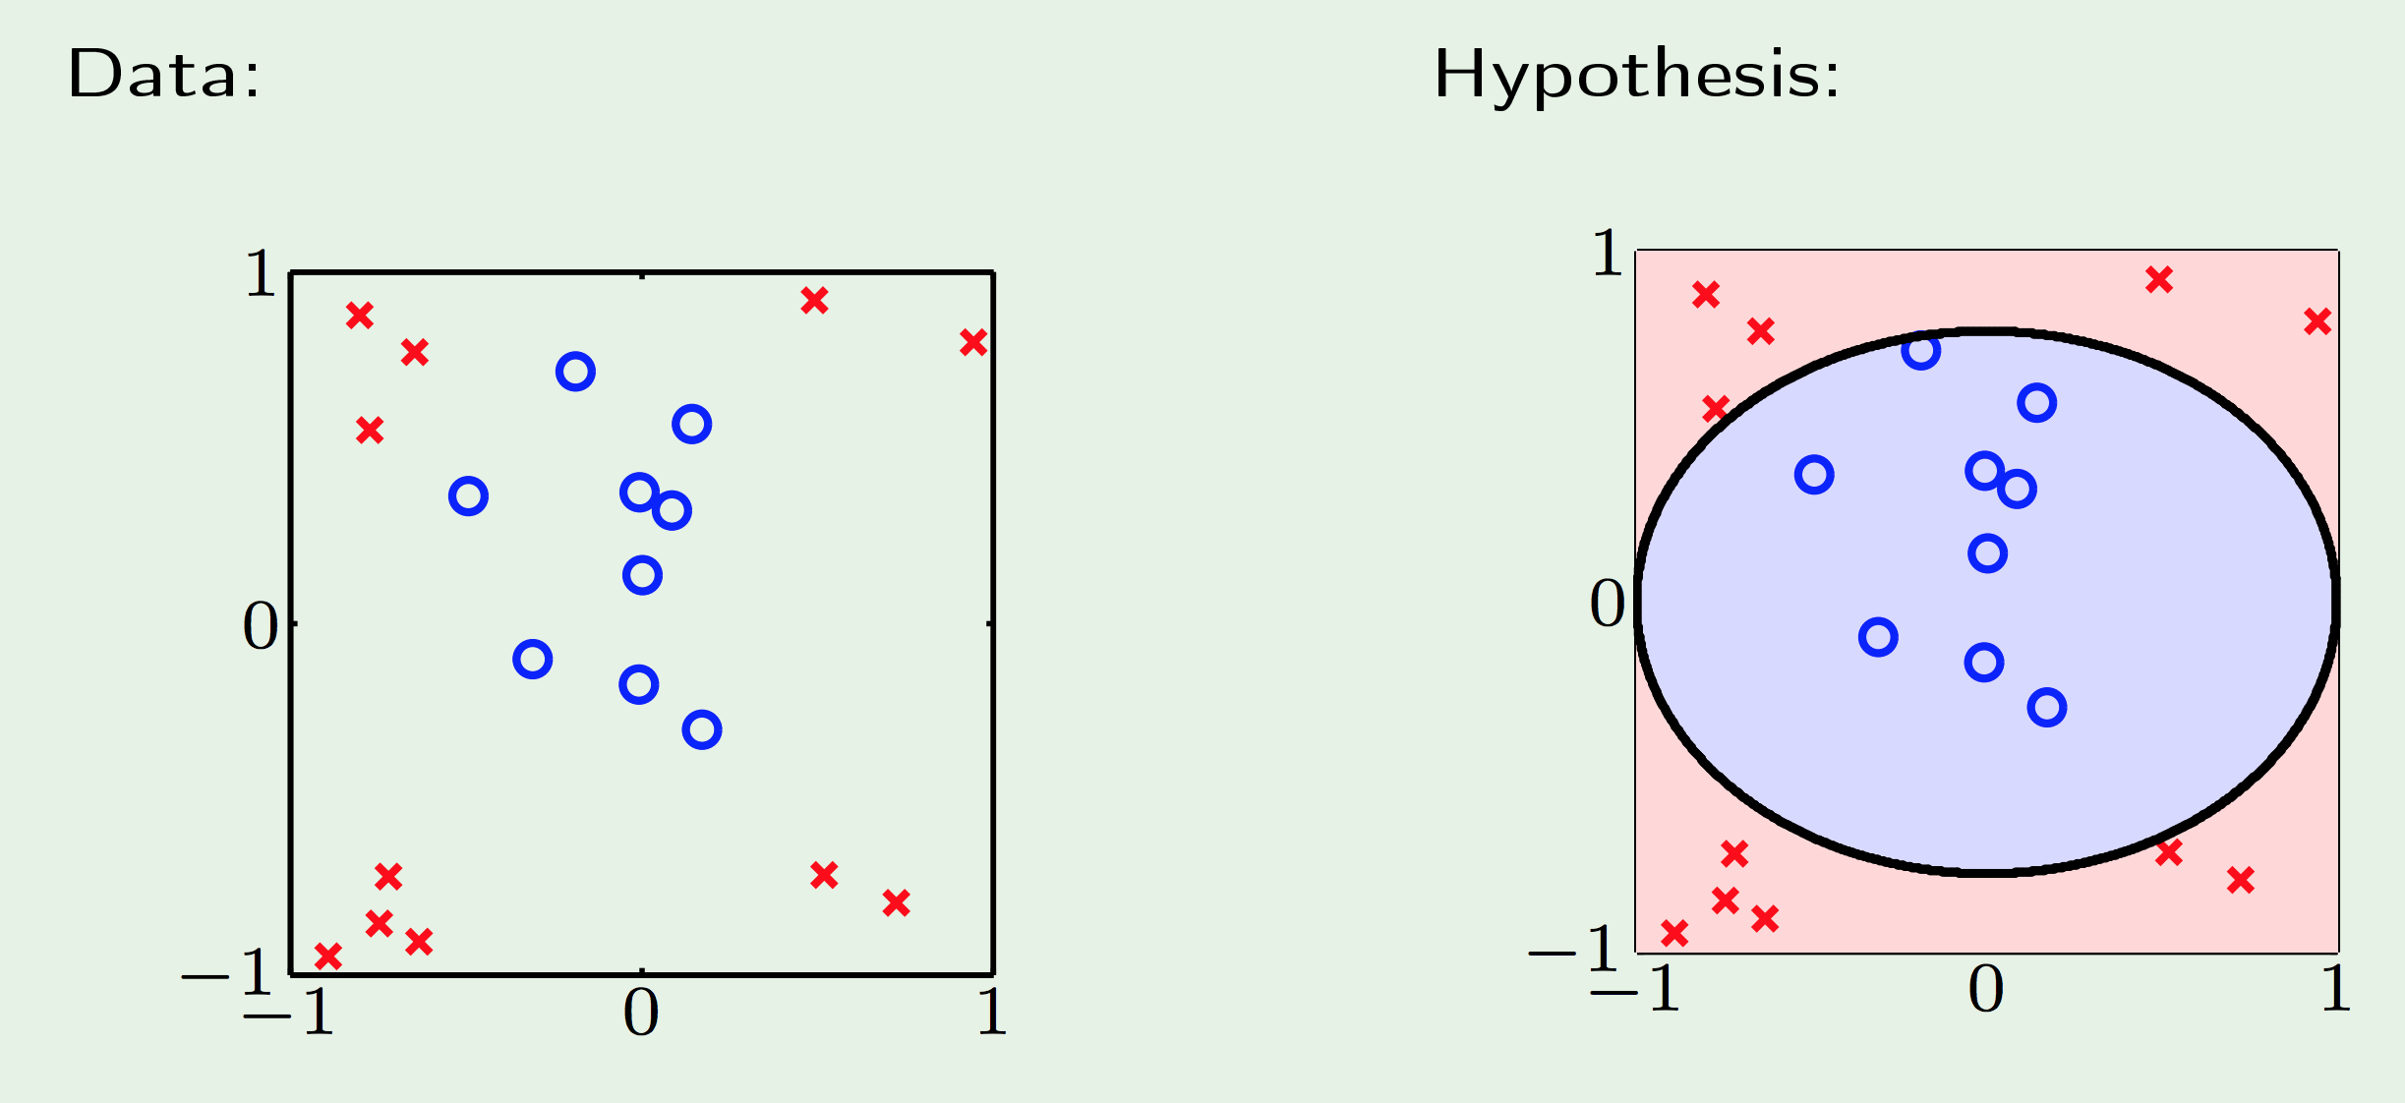
Non-Linear Transformation

Slide 28
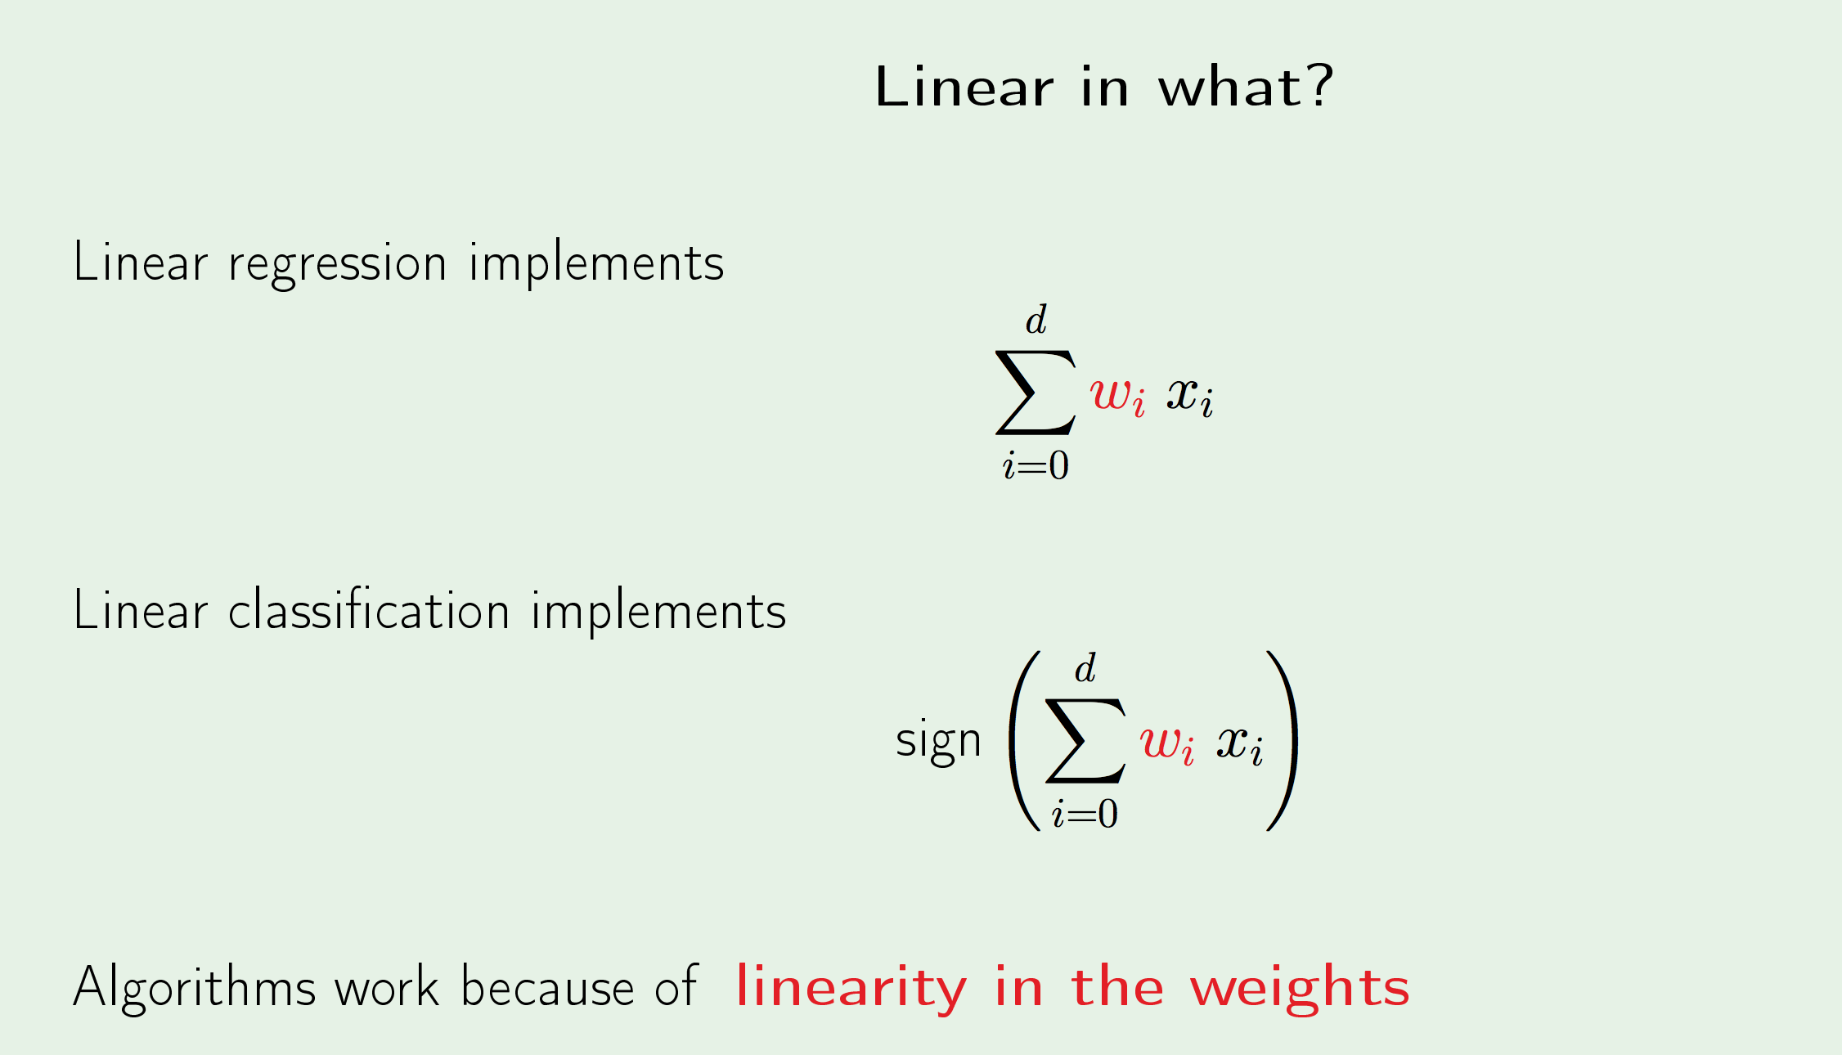
Non-Linear Transformation

Slide 29
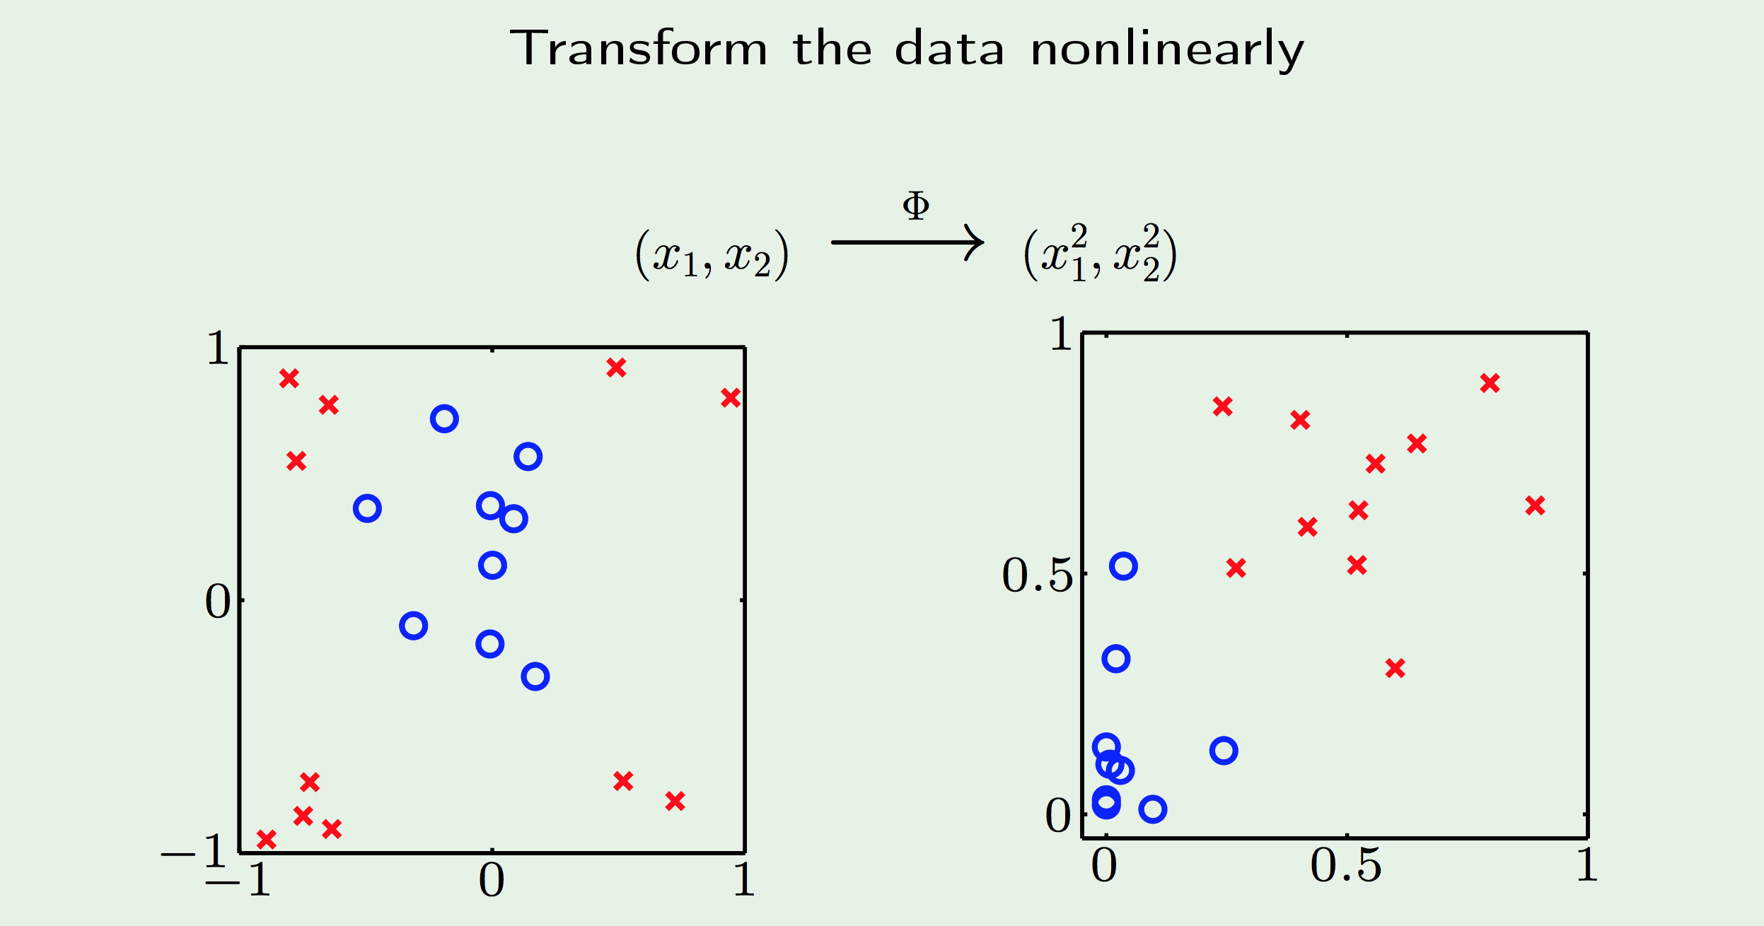
Non-Linear Transformation

Slide 30
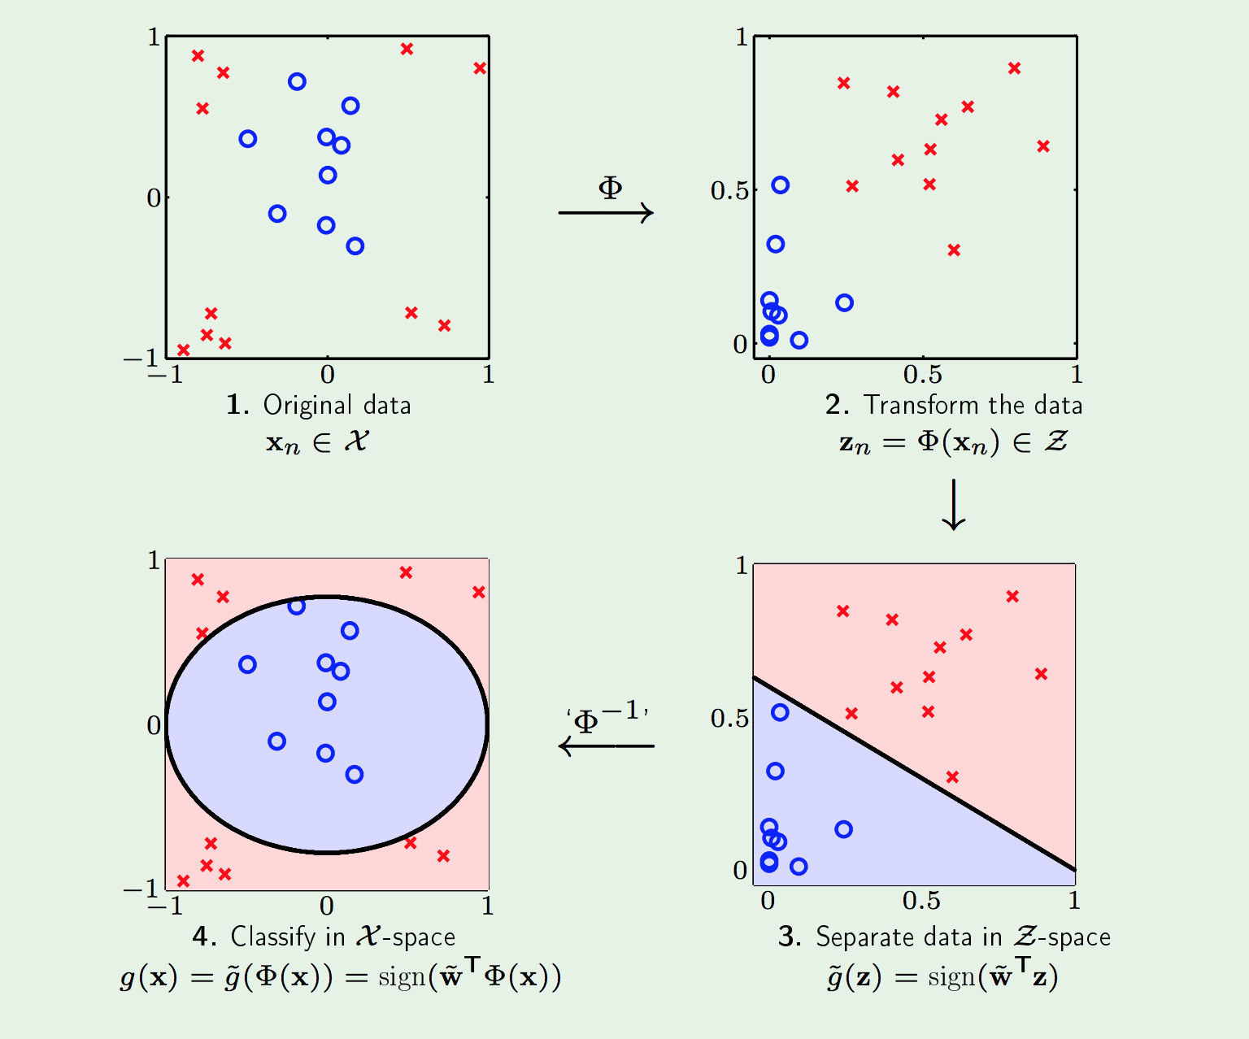
Non-Linear Transformation

Slide 31
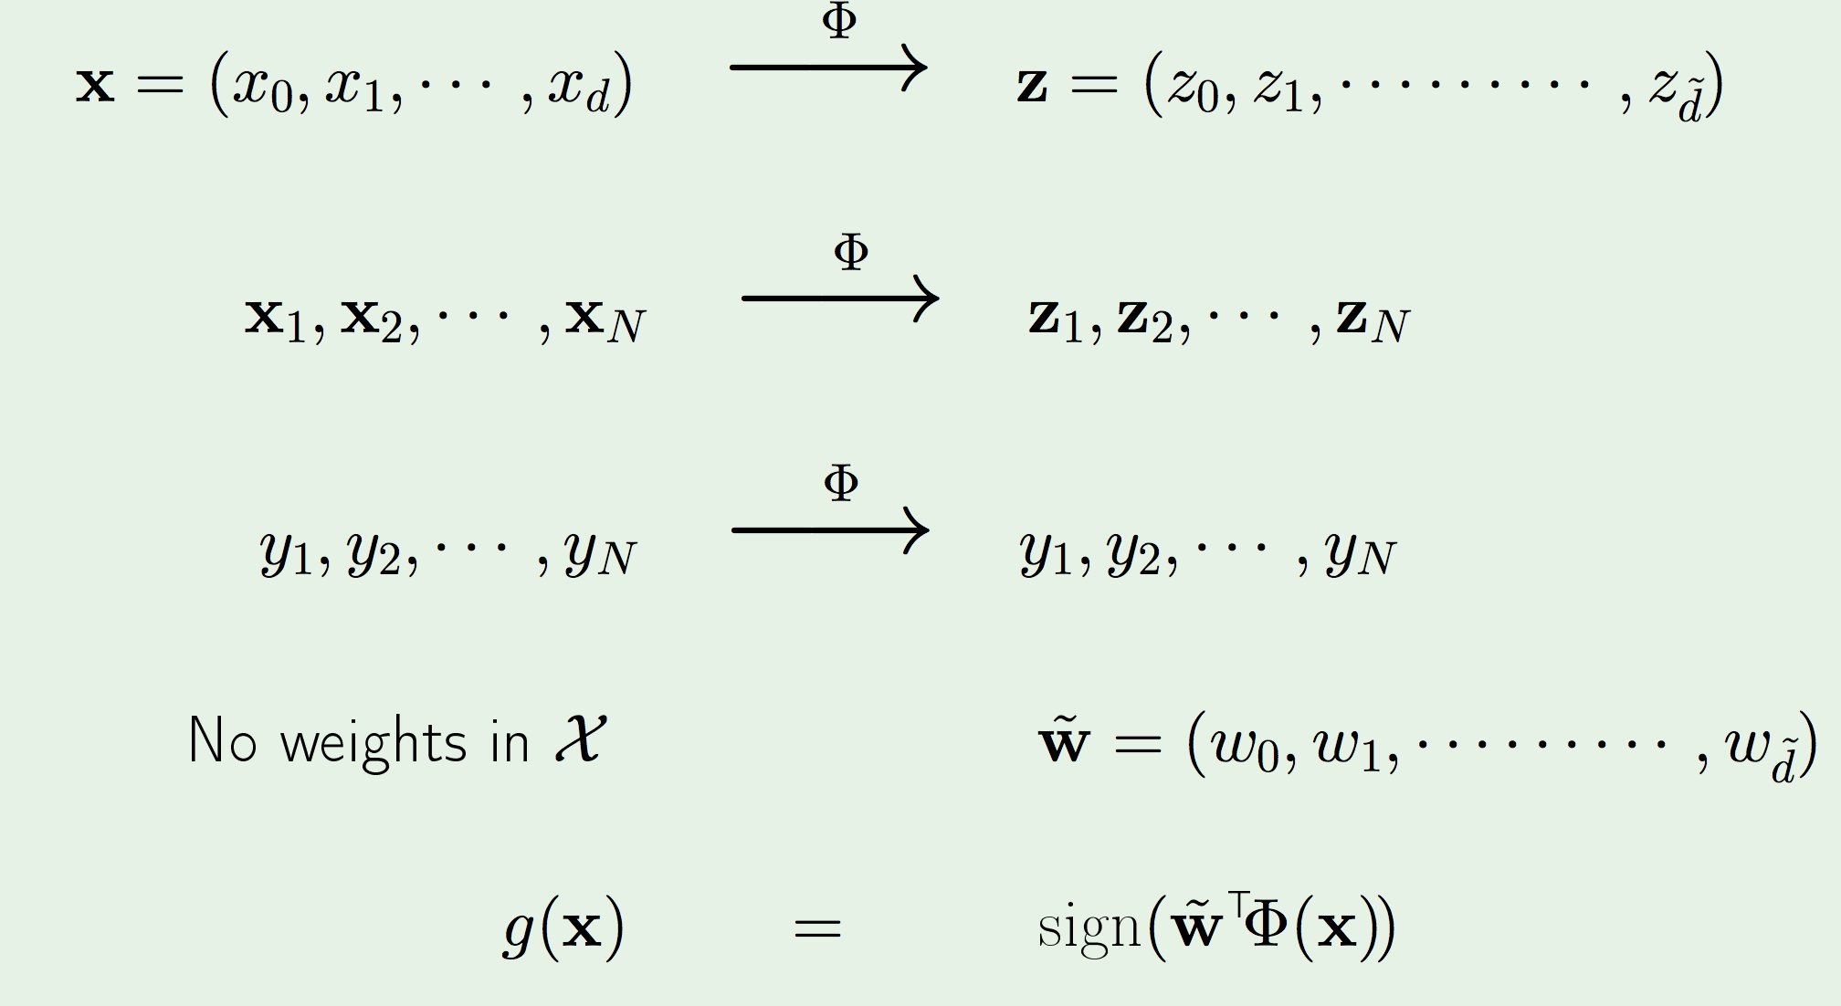
Non-Linear Transformation : What transforms to what

Slide 32
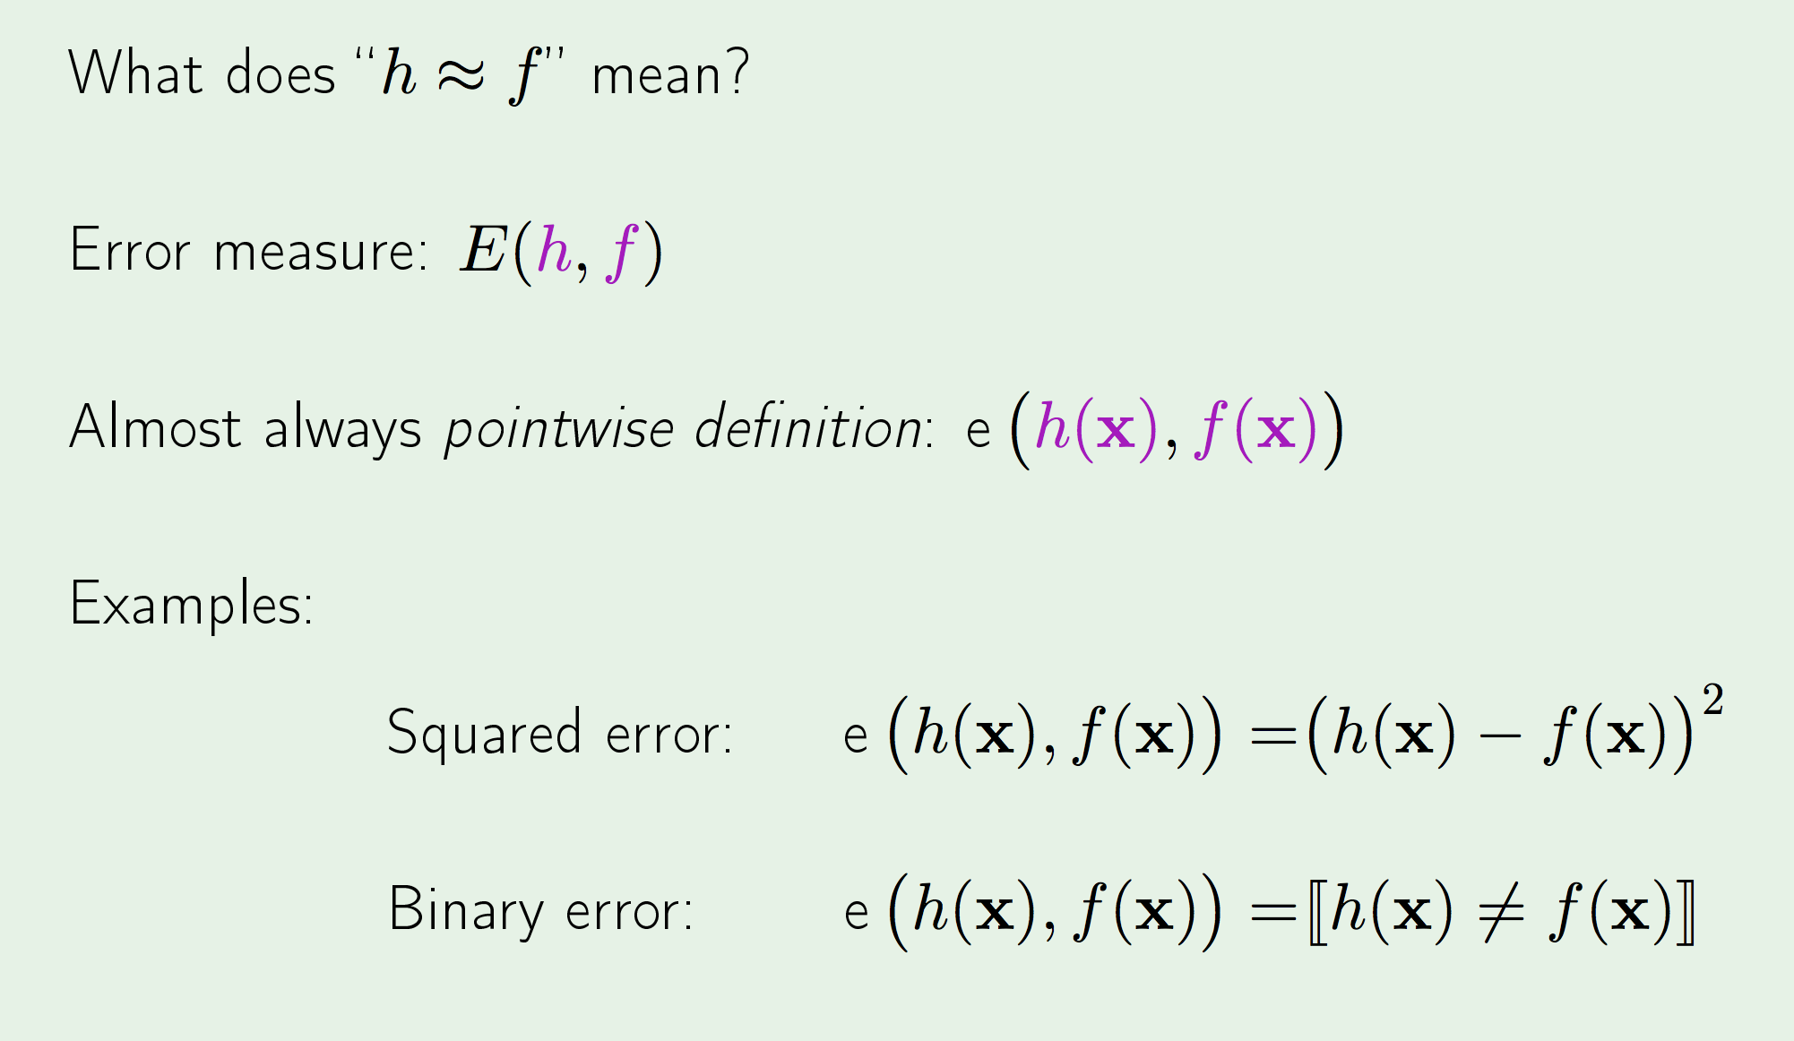
Error Measures

Slide 33
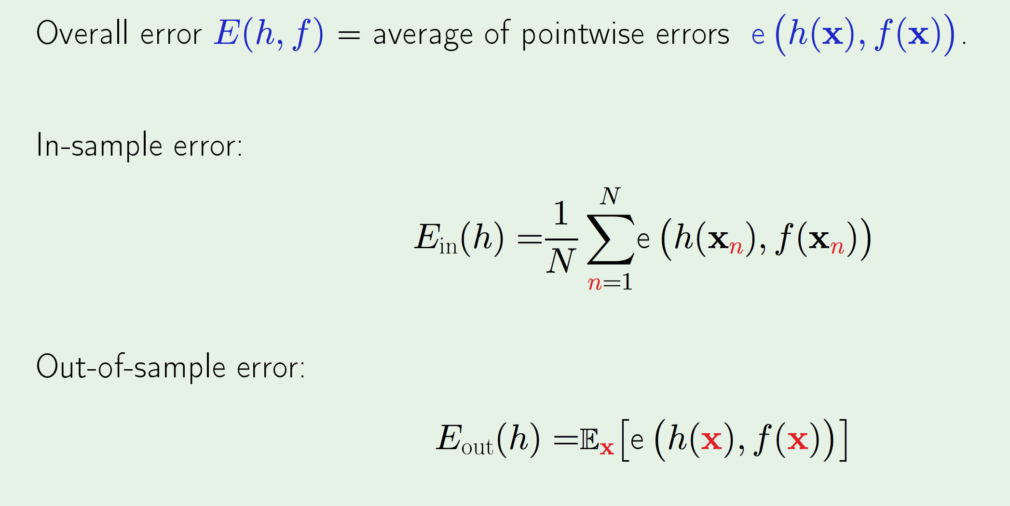
Error Measures

Slide 34
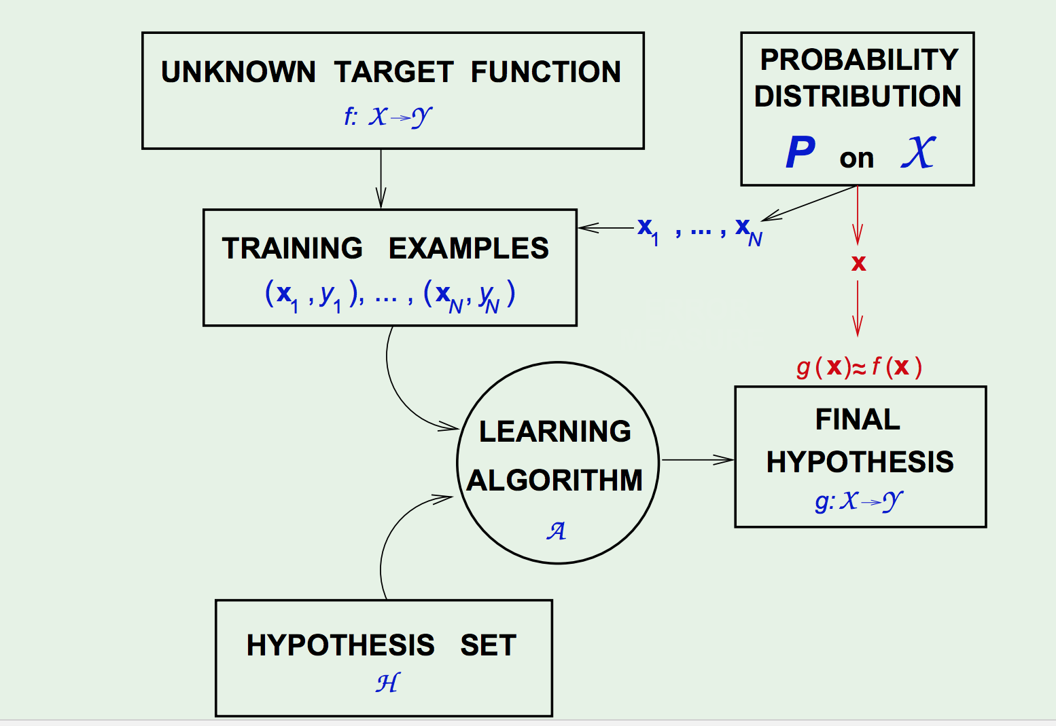
Error Measures

Slide 35
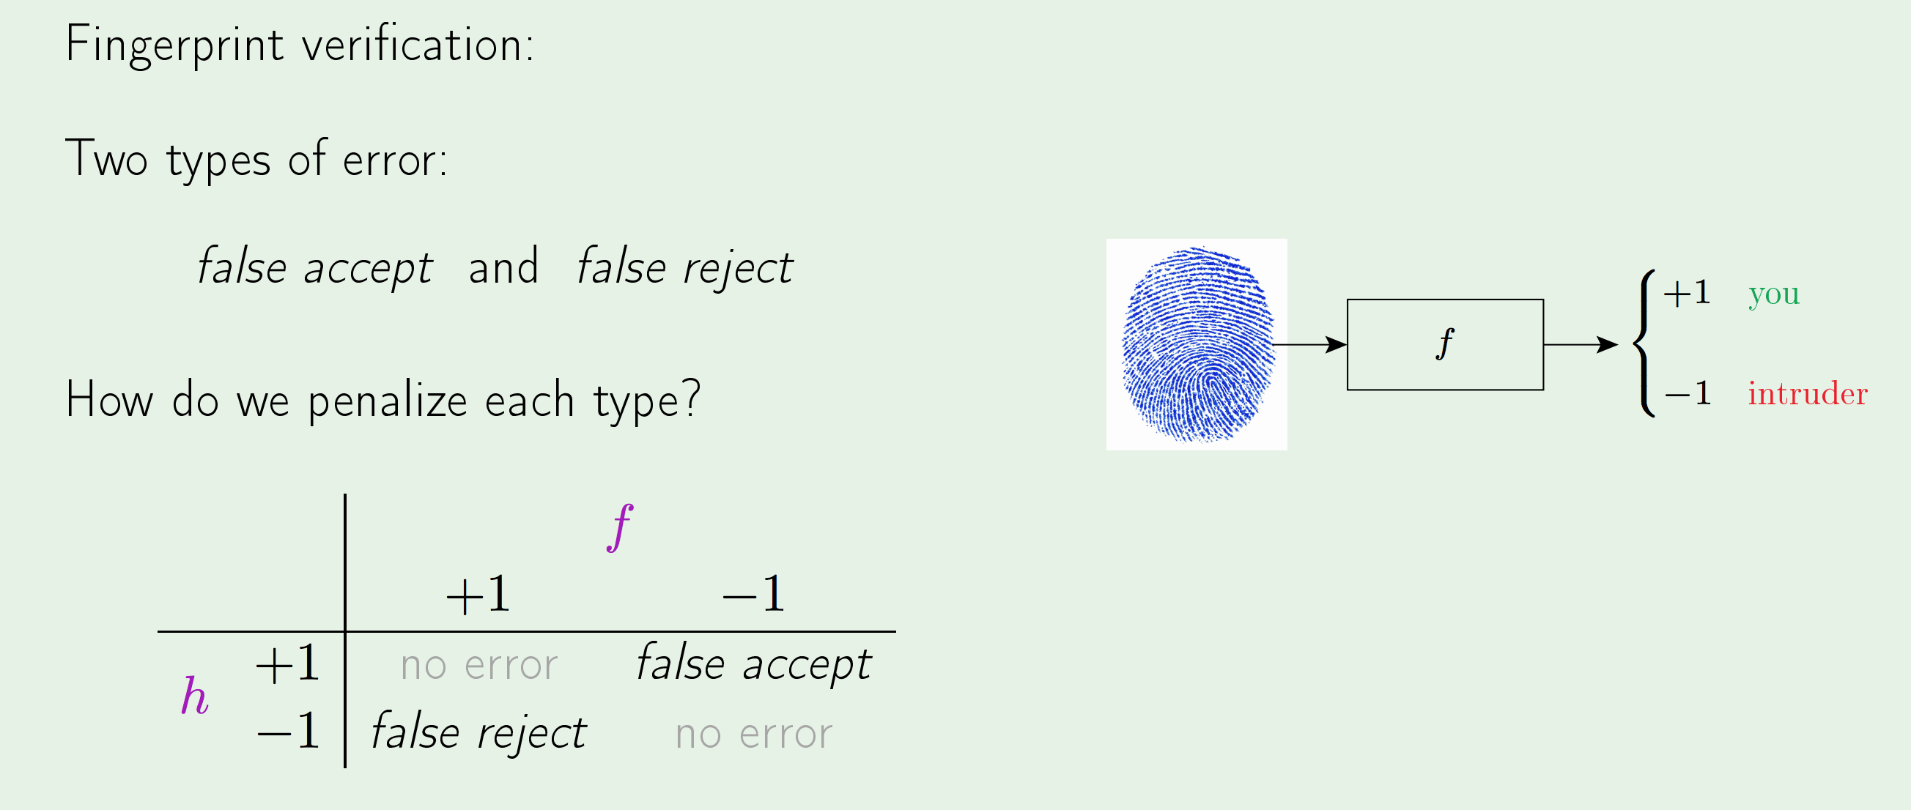
Error Measures

Slide 36
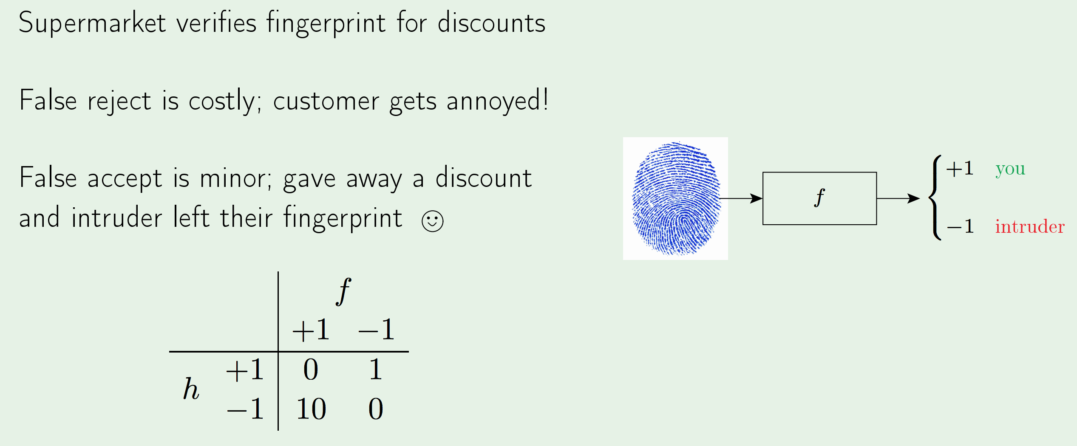
Error Measures – Supermarket Scenario

Slide 37
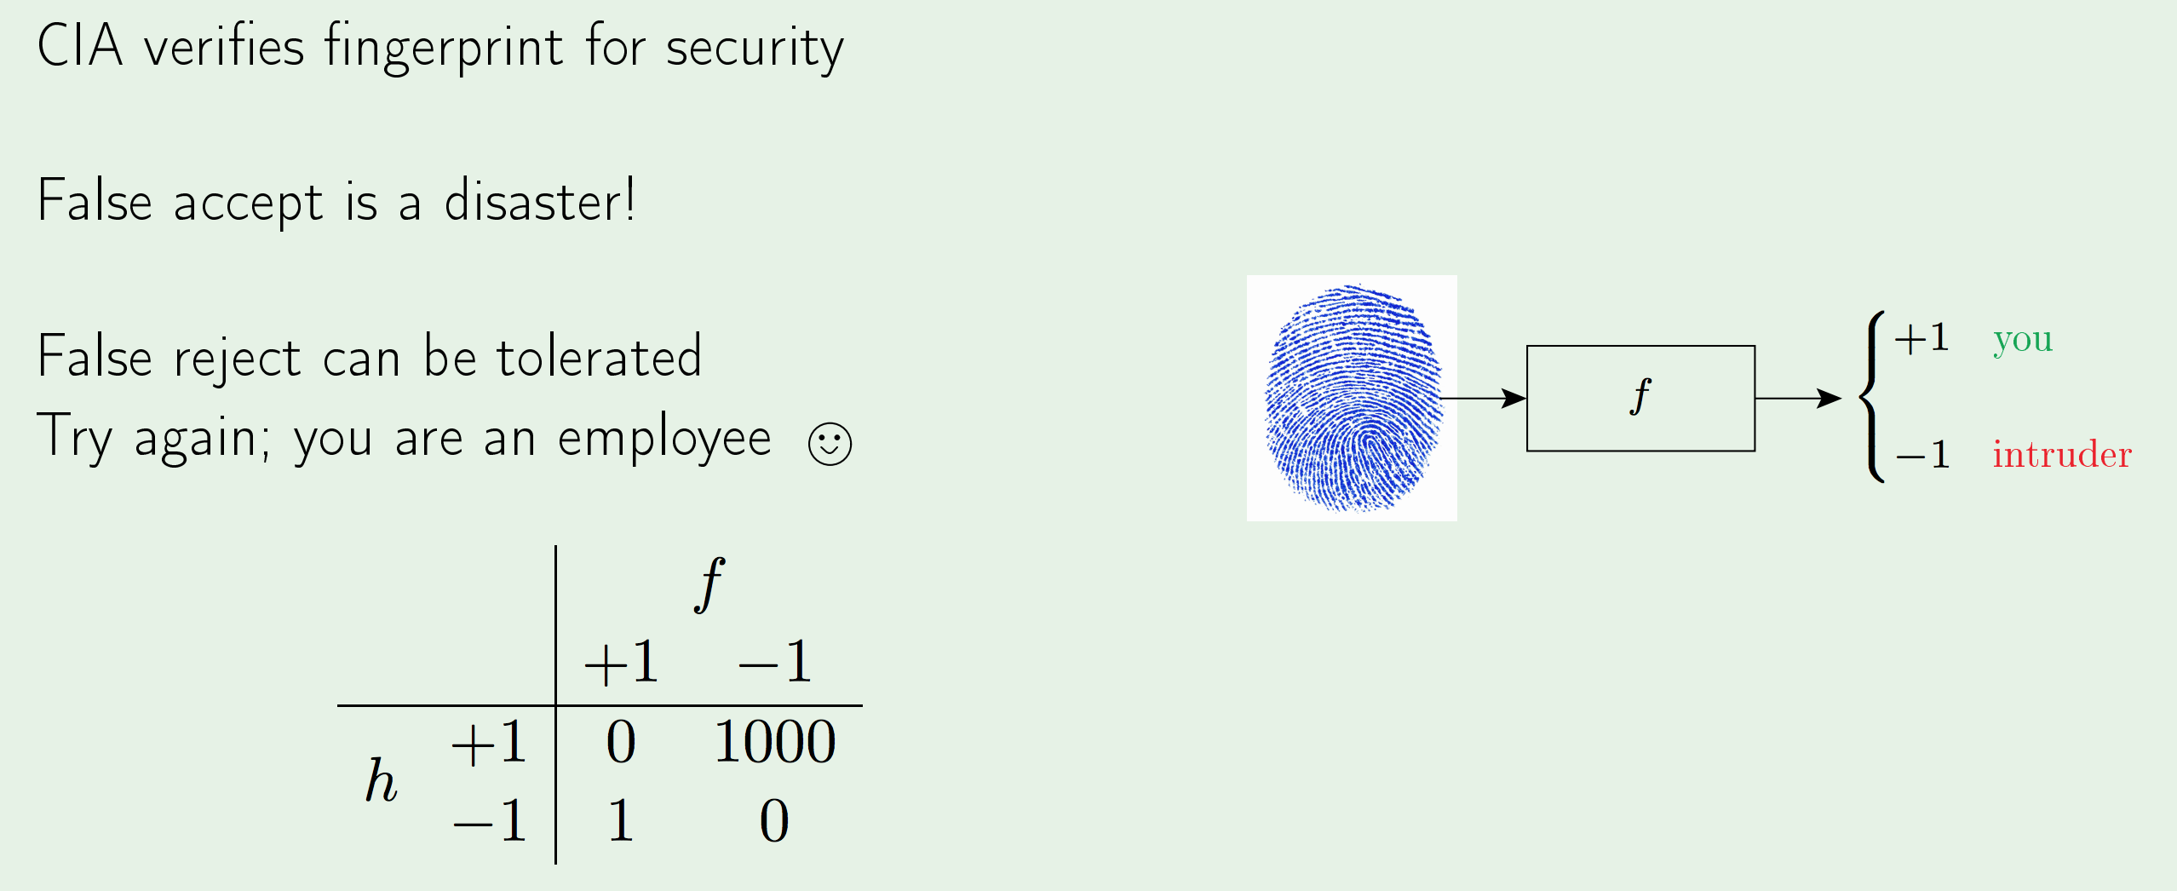
Error Measures – CIA Scenario

Slide 38
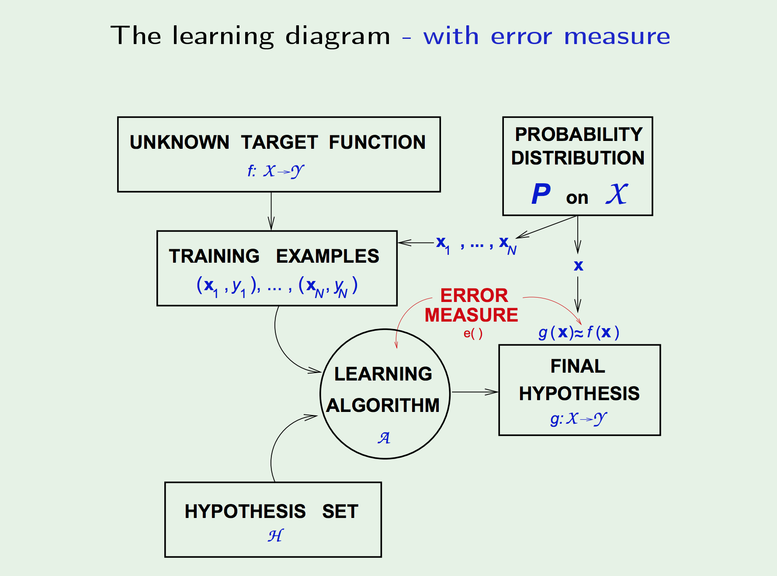
Error Measures

Slide 39
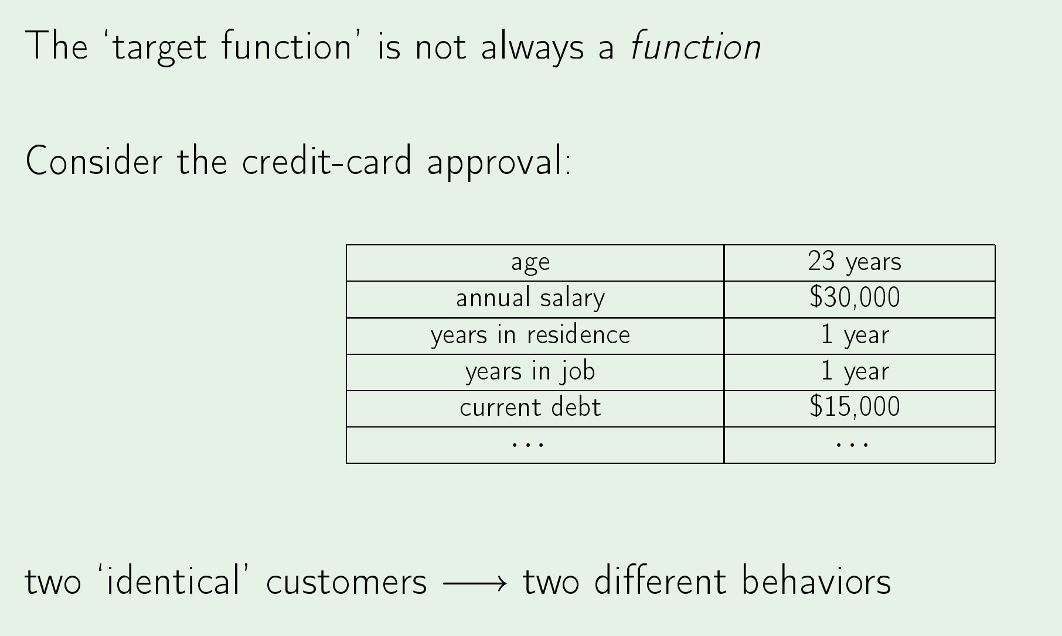
Noisy targets

Slide 40
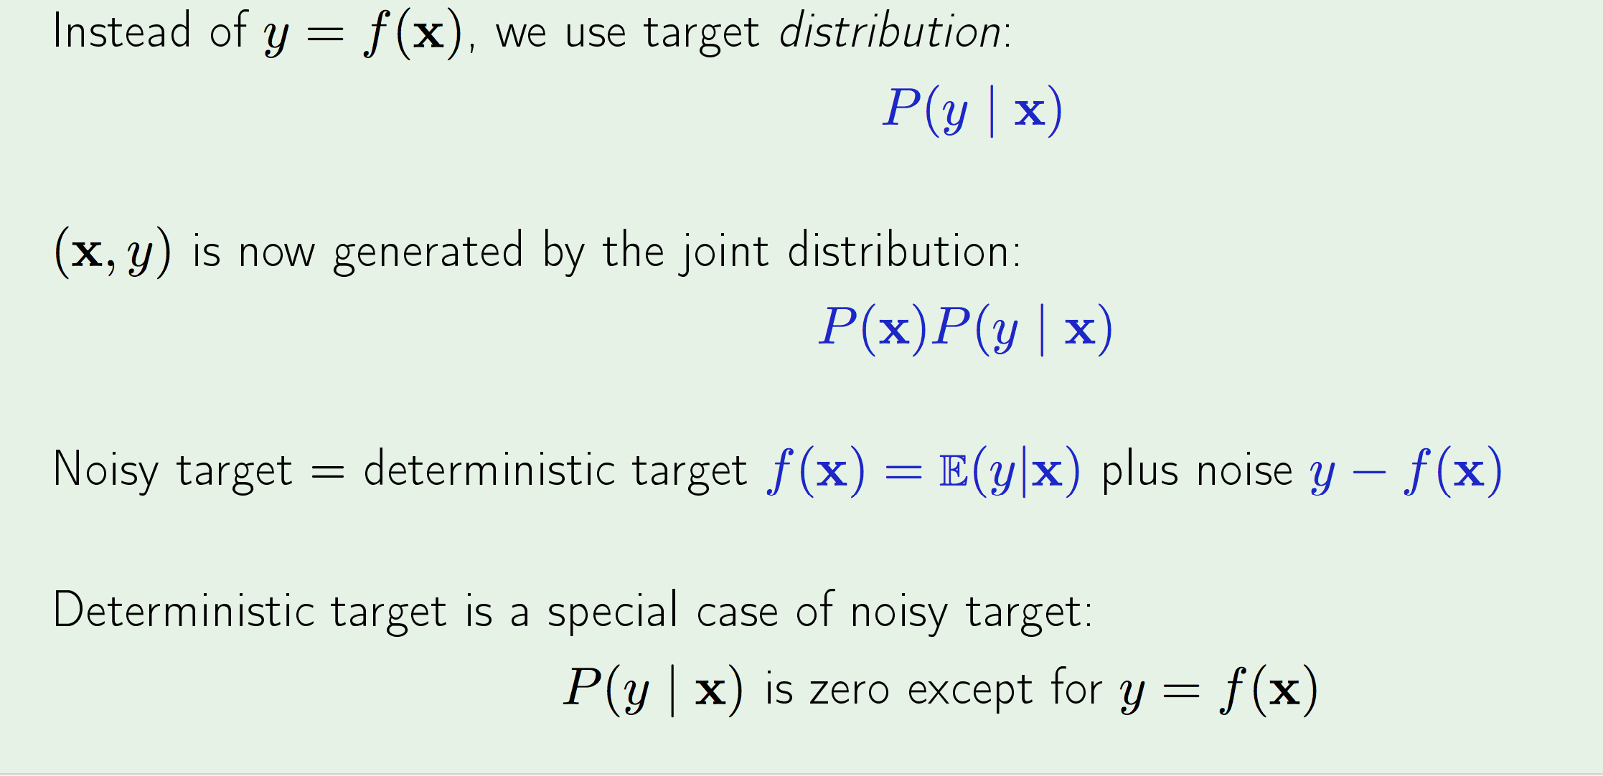
Noisy targets –Target distribution

Slide 41
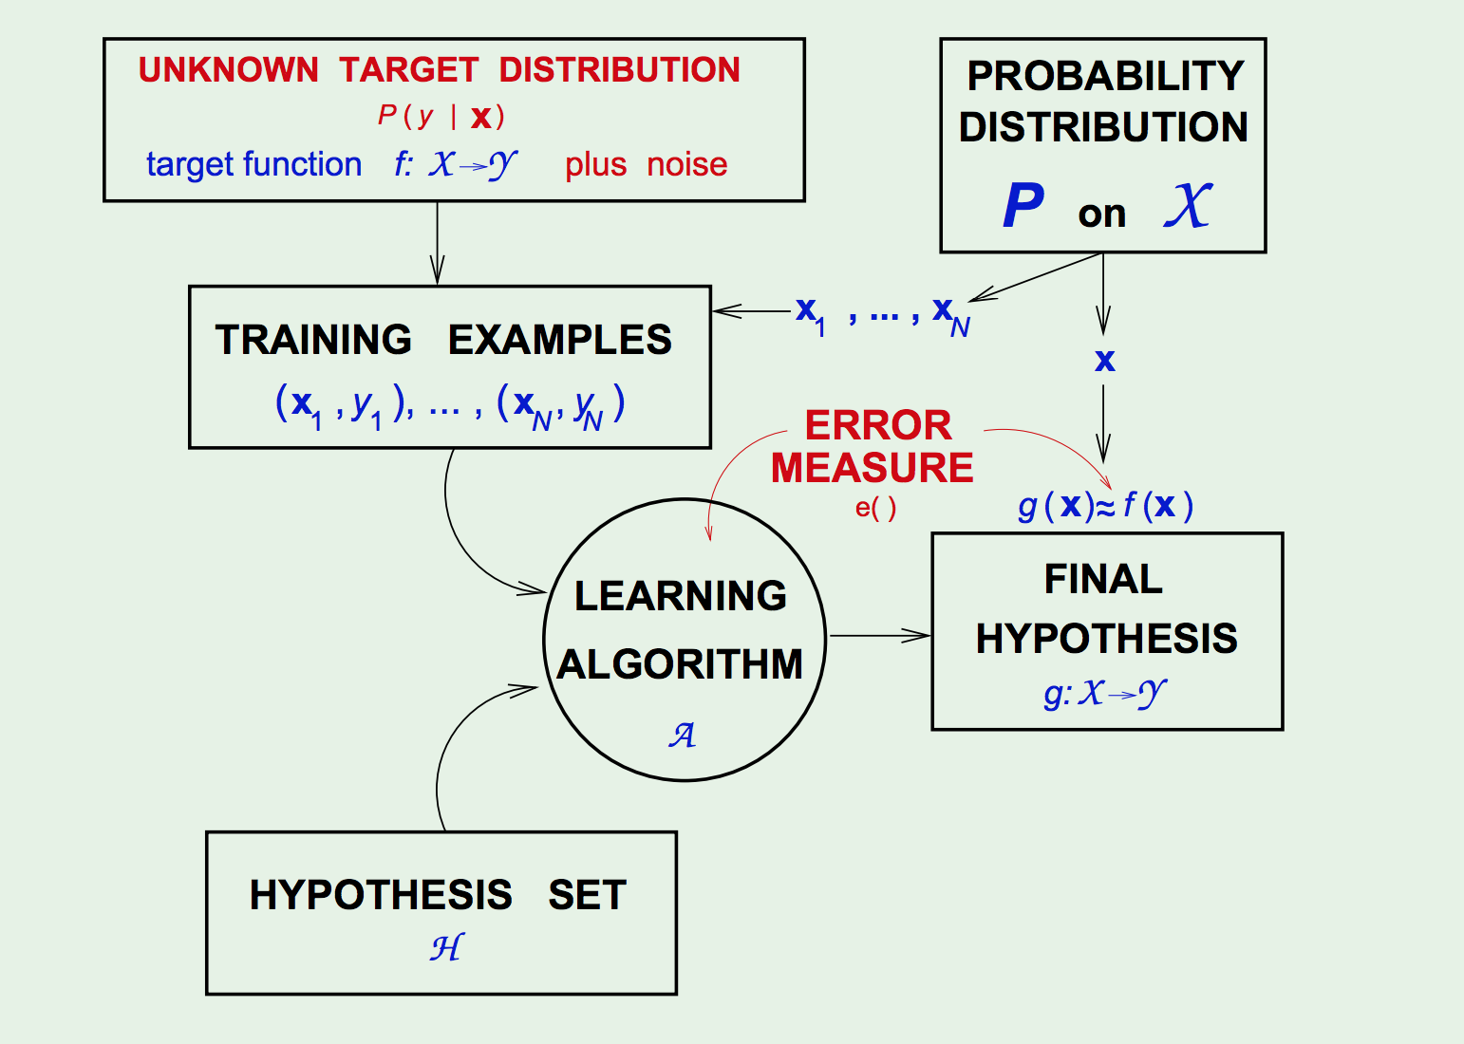
Noisy targets –Target distribution

Slide 42
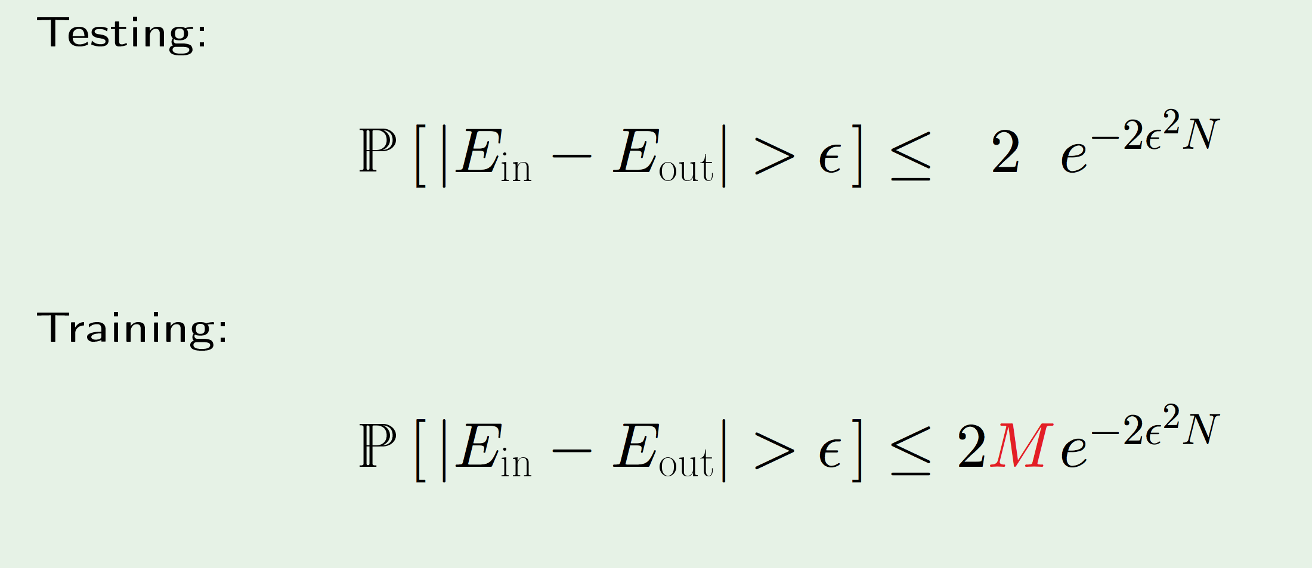
Training v/s Testing

